Slide 1

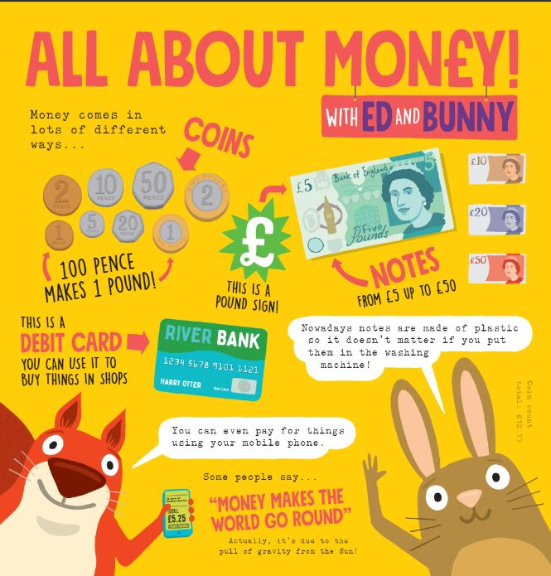
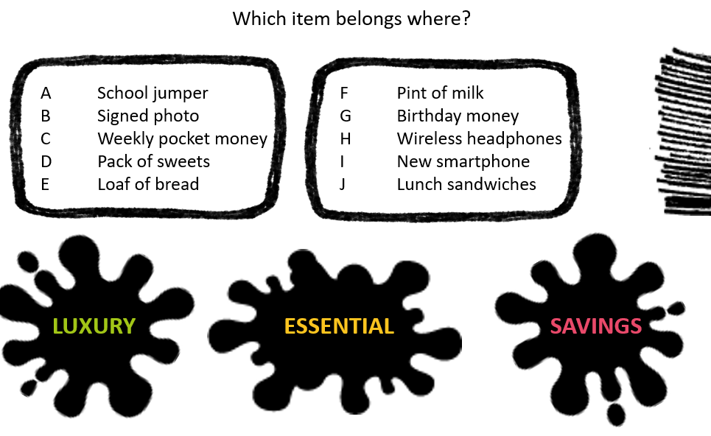
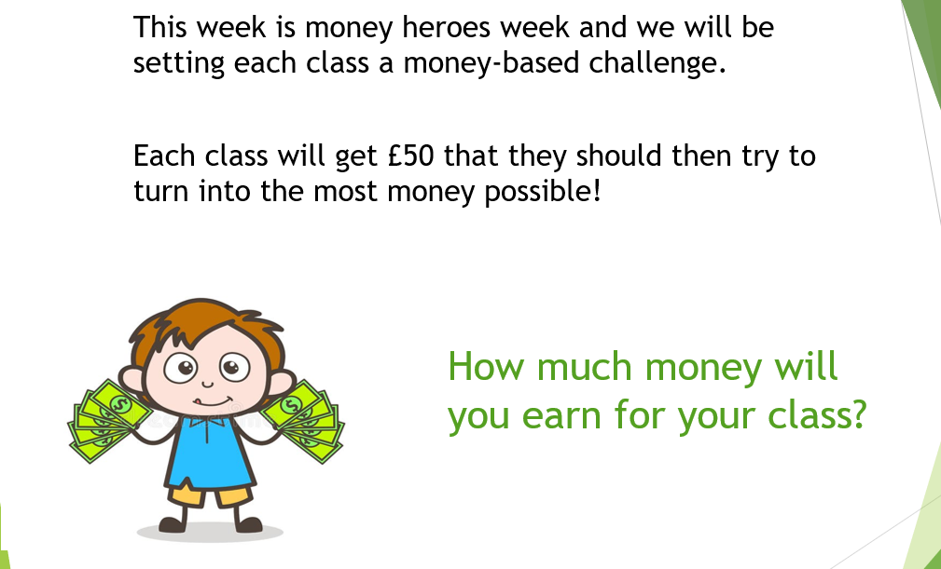

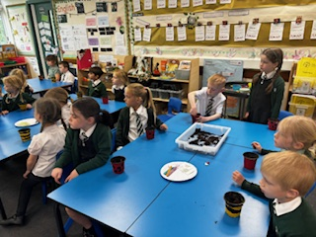
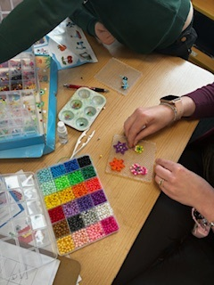
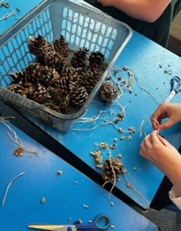
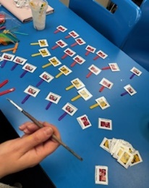
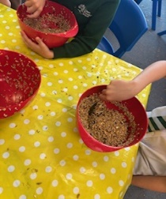
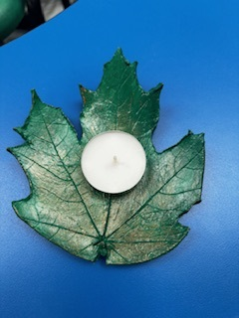
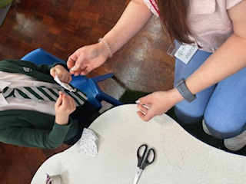
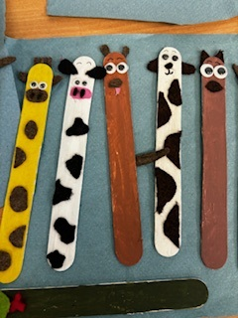
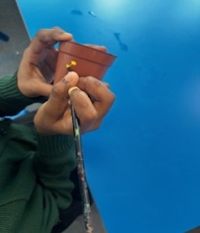
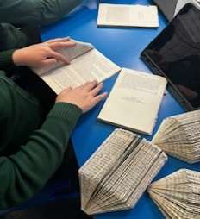
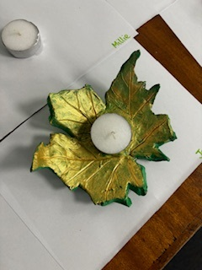
Money Week
23.05.2024
What an incredible week! The children started the week off with an assembly learning all about the different ways that money can be used – spend, save, grow. We discussed what items are considered as luxury and which are essentials and the different ways that are available as spending options e.g. credit cards, debit cards, cash. We even talked mortgages, tax and the advantages and disadvantages of modern technology.
In class the children learnt about a variety of things to do with money…
Learning how to total costs to ensure they can afford the items
Budgeting and saving – value for money
Technology and money – the pros and cons of todays financial systems
Importance of being careful
Recognising money
History of money
The importance of keeping a record
The children’s dedication to this market (and the staffs!) has been incredible. They have been so determined to produce items that people will want to buy and ensure that they are of quality…every which way you turned this week someone was making something! It is very clear that the Lawn value of creativity was definitely out in full force! We would also like to take the opportunity to thank the parent volunteers we have had in school this week – this has been incredibly helpful.
‘DREAM, BELIEVE, ACHIEVE’

Slide 2
Money Week
23.05.2024
So what did the children have to say…..?
‘I absolutely loved money week – we got to use all our creative skills in the products that we designed and made’
‘I enjoyed making the bracelets – it was fun, but also I got to design my own ideas, choosing the beads and the colours’
‘We were given £50 as a class and we have made over £500 bracelets….we have been working out how much profit we might make if we sell them all!’
….and what did our parents and carers say?
‘DREAM, BELIEVE, ACHIEVE’

