Slide 1

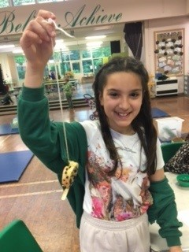
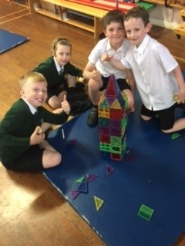
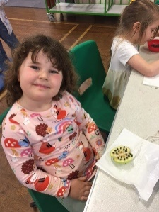
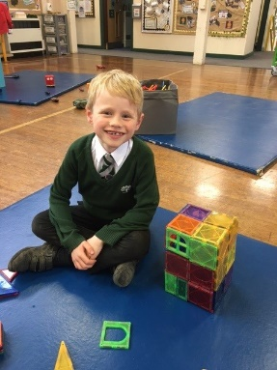
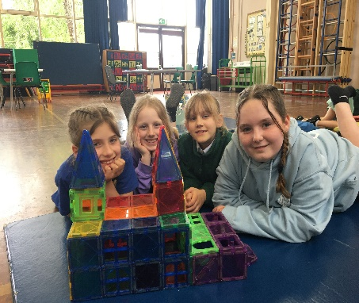
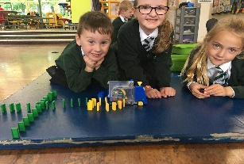
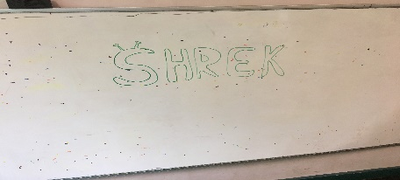
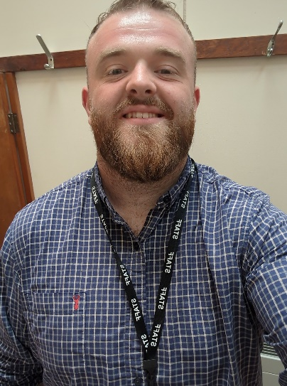
Treehouse Newsletter
Summer 2024
Welcome to the latest Treehouse Newsletter of the academic year. We have had an excellent year so far, we’ve been exploring new areas and we’ve enjoyed seeing the children develop as people, both in their play time and their education.
Who is in the Treehouse team?
Mr Gregory, Mrs Buxton, Mrs Copeland, Mr Yusuf, Miss Bucklow, Mrs Swain, Mr Billings, Mrs Holder, Mrs Di Girolamo & Mrs Billings. We also have Mrs Hambleton and Mr Hancock visiting Treehouse throughout the week.
What times do Treehouse run and how do I book?
Treehouse runs Monday to Friday. Breakfast Club opens at 07:00am and we take the children to their classes just before the gate opens at 8:40am. The After School Club closes at 18:00. We do offer part sessions as well, please call the office on 01332 550178 or email Treehouseclub@lawn.derby.sch.uk for more information.
What do I do if I need to cancel?
For safeguarding reasons, please always inform us if you need to cancel your child's place with as much notice as possible. This means we can release the space for others on the waiting list.
To cancel please ring 01332 550178.
Treehouse Manager – Mr Gregory
Let me take this opportunity to introduce myself to you all! I am Mr Gregory, some of you will have seen me at the gate in the evenings, I’ve been working at Treehouse since October 2023 and I’ve been a part of Lawn since February 2023, having started working in the kitchen. I’m now Treehouse Manager so if there’s anything you want to discuss please feel free to get in contact! My background is the world of football coaching, I spent 5 years with an u13s football team, taking them up to u18s level this year, so I love getting outside with the children to help them develop their motor skills and nurture their interests in sport. I also play for a rugby team in Derby so often enjoy chucking the ball around with those who are interested!
‘DREAM, BELIEVE, ACHIEVE’

Slide 2
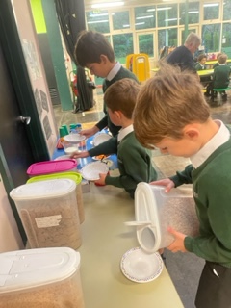
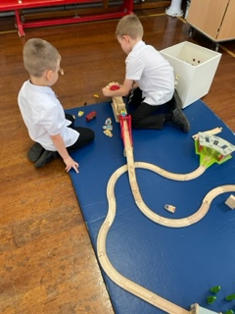
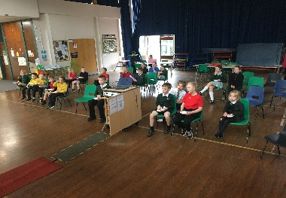
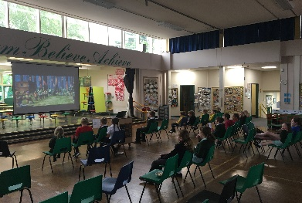
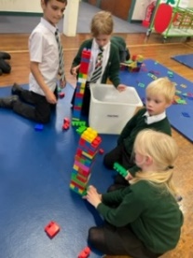
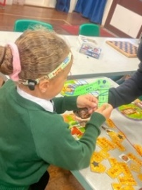
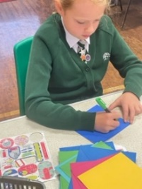
Treehouse Newsletter
Summer 2024
What do the children eat?
For breakfast there is a choice of different cereals, toast, crumpets, bagels and pancakes, fresh fruit and yoghurts. The children are very independent and we encourage them to make healthy choices. They can also help themselves to water and milk. In the evening there is a light snack, this is not a full meal and is only to keep them going until they have tea at home. Again, in addition, there is also fresh fruit and yoghurt.
Safeguarding
Safety of every pupil is always our key priority. All members of the Treehouse team are trained in Safeguarding.
DSL: All SLT members, Mr Gregory.
First Aiders: Mr Billings, Mrs Copeland, Mrs Swain, Mrs Billings, Mrs Buxton, Mrs Di Girolamo.
Children requiring medication must have it signed in following school policy via the Reception team. All pupils with allergies are catered for.
Where do I drop off and collect?
Drop off and collection is through the KS2 gate. There is a buzzer that links to the hall. Children are encouraged to enter independently. Please do not come through the gate with your child, a staff member will come up if needed. Children will be brought to you at the gate for collection. KS1 children are collected from their classroom at the end of the school day by a Treehouse staff member if attending.
Can I use childcare vouchers?
Simple answer is yes, it works slightly different depending on which vouchers you are using. Mrs Hennessy in the school office is able to guide you if you are having any problems.
Activities
The children have explored a range of activities this year. We have had a Film Night, during which we all watched Shrek and had bowls of popcorn or marshmallows; we have explored the Dark Ages and the craft of writing runes during Viking Day; we also regularly break out our dancing skills whilst dancing along to Just Dance! We regularly run crafts too, often based on a national/international theme (eg. Making bird feeders out of milk bottles during Recycling Week).
Can I donate games, small world items etc if they are still good quality?
Absolutely!! We are very grateful.
‘DREAM, BELIEVE, ACHIEVE’

