Slide 1

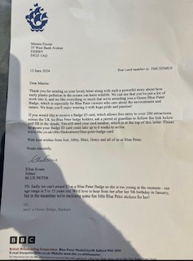
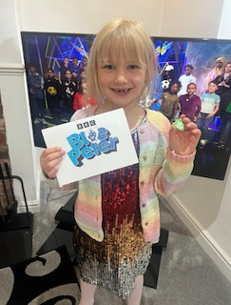
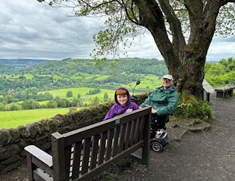
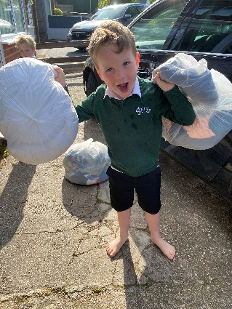
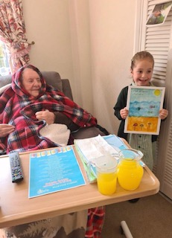
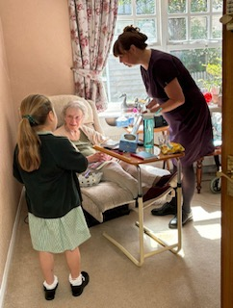
Community Action Week
June 2024
Community Action Week is just one way that pupils across Transform Trust, staff and families work together to show their care, appreciation and respect for others. It allows our pupils at Lawn another opportunity to put into practice the values that are part of every day life here, those that are fully embedded across all our curriculum. #respect #responsibility #initiative #creativity #integrity and the Trust values of kindness.
As always the children rise to the challenge and show that they are true citizens, willing to go above and beyond to have a positive impact on others.
Take a look at the things that happened within the Allestree Community and at Lawn……
Marnie wrote a letter to Blue Peter about plastic pollution…a very important topic.
Charlie has taken his grandad out to his favourite spot in Derbyshire. He has dementia but the smile on his face said it all
Eva went to Brookfields Nursing Home in Littleover this afternoon with her Daddy Steve to take some paintings she did for the residents! A lovely act of kindness for community week. She was given a little ‘Brookfield’s bear’ to take home with her and the idea is that she will take photos with him on adventures and they will put the photos up at the care home. So proud of her ❤️☀️
Harley has been keen to take part in the community challenge. We baked some lemon and white chocolate cupcakes for a neighbour (a nurse) to take to work. We also did some litter picking around the neighbourhood. Harley was actually disappointed at the amount we found.
William in Year one has donated ALOT of his and his brother’s clothes. The boys sorted them out and even gave away some beloved Toy Story clothes. They know that they will go to someone who will treasure them as much as they have done plus the sale of them will raise money for worthy charities. Well done boys!
‘DREAM, BELIEVE, ACHIEVE’

Slide 2
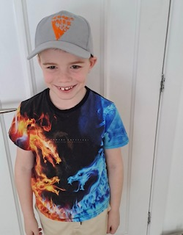
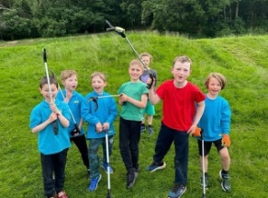
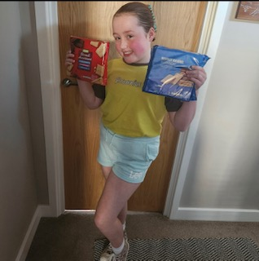
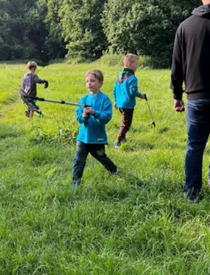
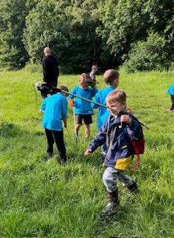
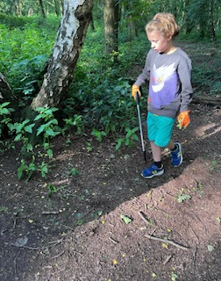
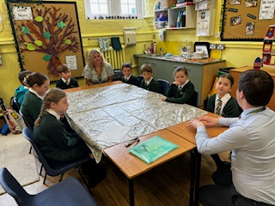
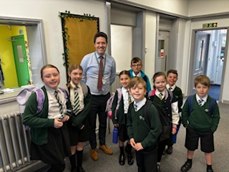
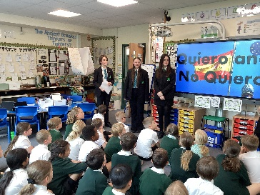
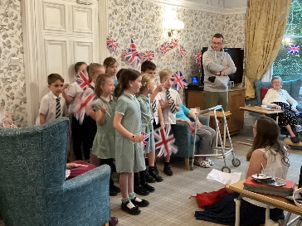
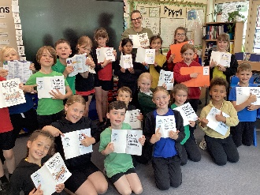
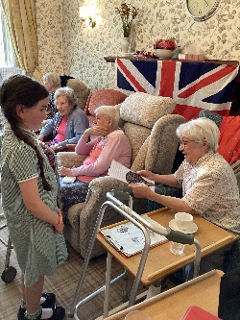
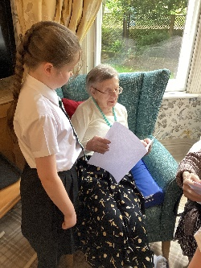
Community Action Week
June 2024
As part of Community Action Week, some Lawn pupils who are members of the 151st Allestree Beaver group, took part in a group litter pick around Allestree Park. They worked really hard to help make the park a nice litter-free space for everyone to enjoy.
Well done to:
Thomas Yeates
Archer Hicks
Gregory Buchanan
Joey Clemens
Eshan Smith
Leo Poon
Eddie Atkinson
James Byrne
Duncan Buchanan
Ashton purchased a 'Windrush' cap out of his pocket money to help support the Windrush campaign 👏 He has clearly taken a lot on board when learning about this in Year 4.
Cordelia has spent her own money on these biscuits to give to her Brownie group for all the hard volunteer work that they do!
Duncan has helped out at his younger brother’s beaver session this evening for community week, he helped them litter pick in Allestree Park.
The Learning Detectives visited a school in Burton to support their journey of school growth and development ….going above and beyond and impacting on the wider community. They were sensational and we have received a lovely email from Mr Smith thanking them for the incredibly mature and helpful acts.
Language leaders from Woodlands visited and delivered sessions for all of KS2. They were really impressed with the linguistic skills of our pupils. They also kindly gifted dictionaries to school too.
What an impact Y3 had on the residents of the care home….smiles all round and the children have learnt from them too!
#giving back
‘DREAM, BELIEVE, ACHIEVE’

