Slide 1



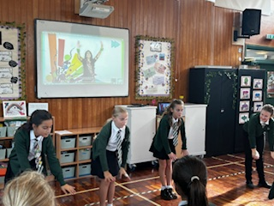
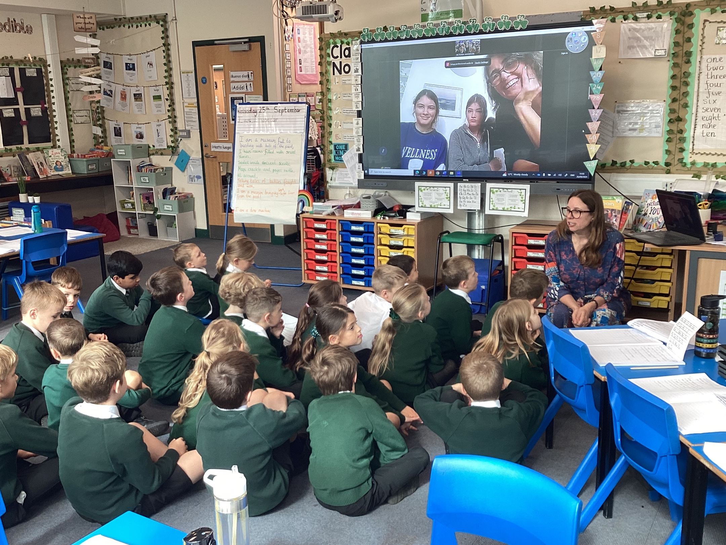
Languages Day
25.09.2024
I think we would all agree in the power of language….it enables communication, sharing of information and the expression of thoughts and emotions. ‘Knowledge of languages is the doorway to wisdom’ and that is why we feel so privileged to have a school community that is language rich and understands the importance of learning a language. Not only that…enjoy learning other languages and engages with the culture and communities that those languages come from. We are also very lucky that we have a language leader in Ms Harrison who is inspirational and creative in engaging staff, children and the wider community in the love of language and staff who can teach quality language lessons.
Did you know…..?
Ms Harrison is fluent in Spanish, with a Spanish husband and regular visits to Spain.
Lawn has 17 different languages!
Our Modern Foreign Language taught in school is Spanish
We are embarking on our journey to learn Makaton together
We run a Spanish club after school and at lunch time
The choir sang in Welsh at Young Voices!
We have Woodland’s language leaders visit school to give taster sessions in different languages
According to our local secondary school…you can always tell Lawn pupils by their language skills, their love of languages and their excellent accents!
Languages Day 2024….What did we get up to?
We watched videos of Makaton and learnt some basic signs to be able to communicate with each other.
https://singinghands.co.uk/about/what-is-makaton/
https://www.youtube.com/watch?v=xxCJxr1LT1M
KS1 pupils had a Bollywood dance workshop delivered by our Language Leaders, Naia, Viola, Sienna and Izzy T. They were incredible with the children!
https://www.youtube.com/watch?v=TgvLOjUAxXs
KS2 pupils experienced different visitors through the day who spoke to them about the languages they speak and the children got to practice their skills….I think animals, food and sport were popular. The lovely ladies in the kitchen made Tiramisu for the older children who were having hot dinners – alcohol free of course! Pupils also had a go and creating their own language based on words that they already know. Spanish Sing Up was great fun! – We know the children love Sing Up so why not deliver it with a twist and sing in Spanish.
‘DREAM, BELIEVE, ACHIEVE’

Slide 2
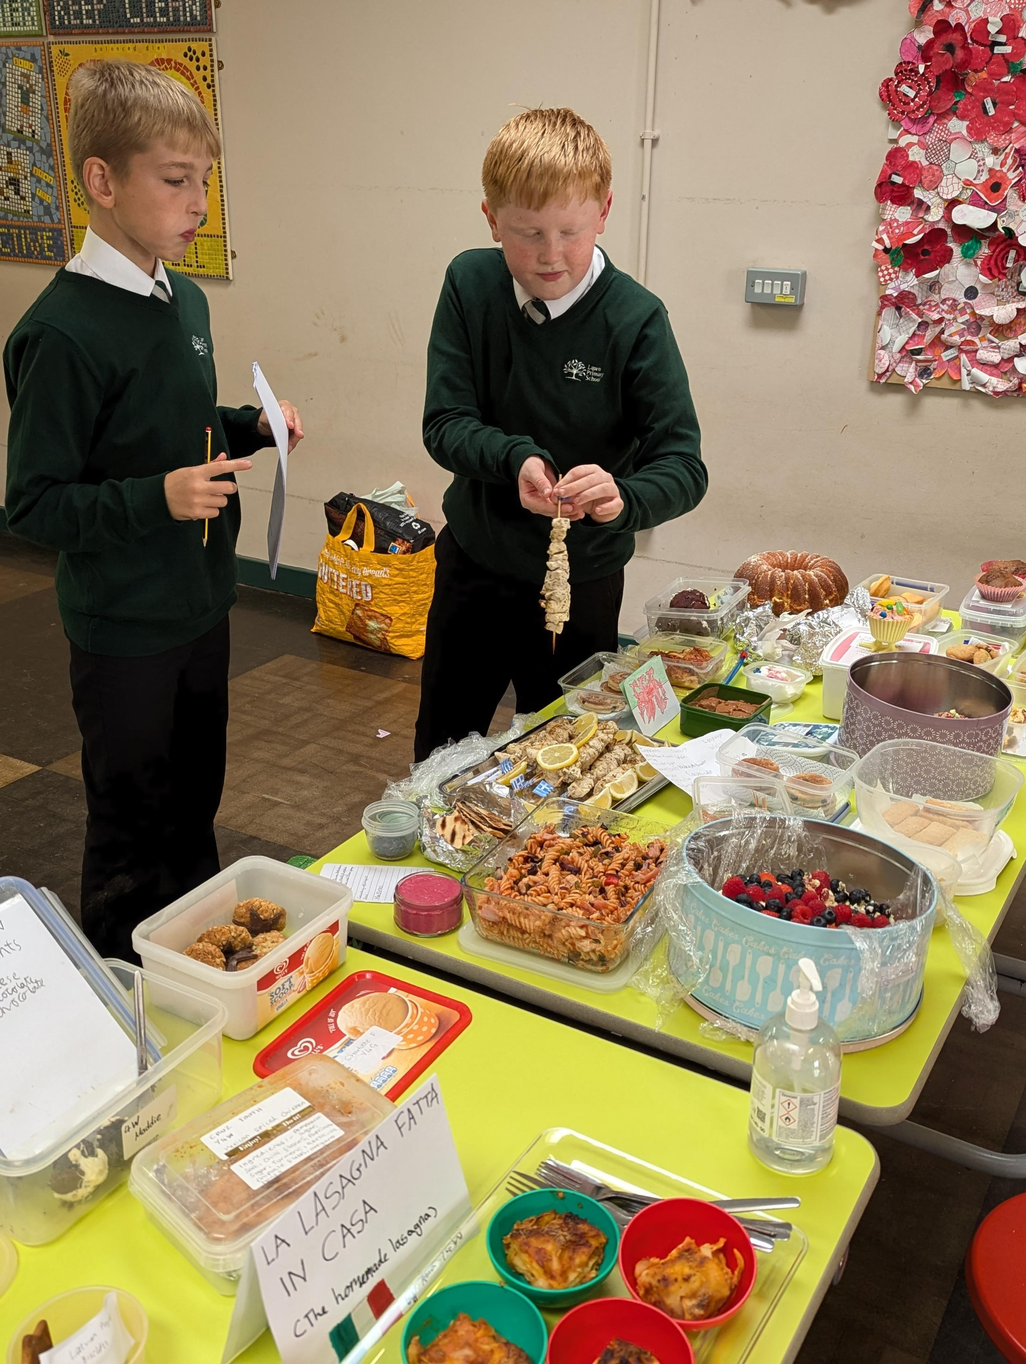
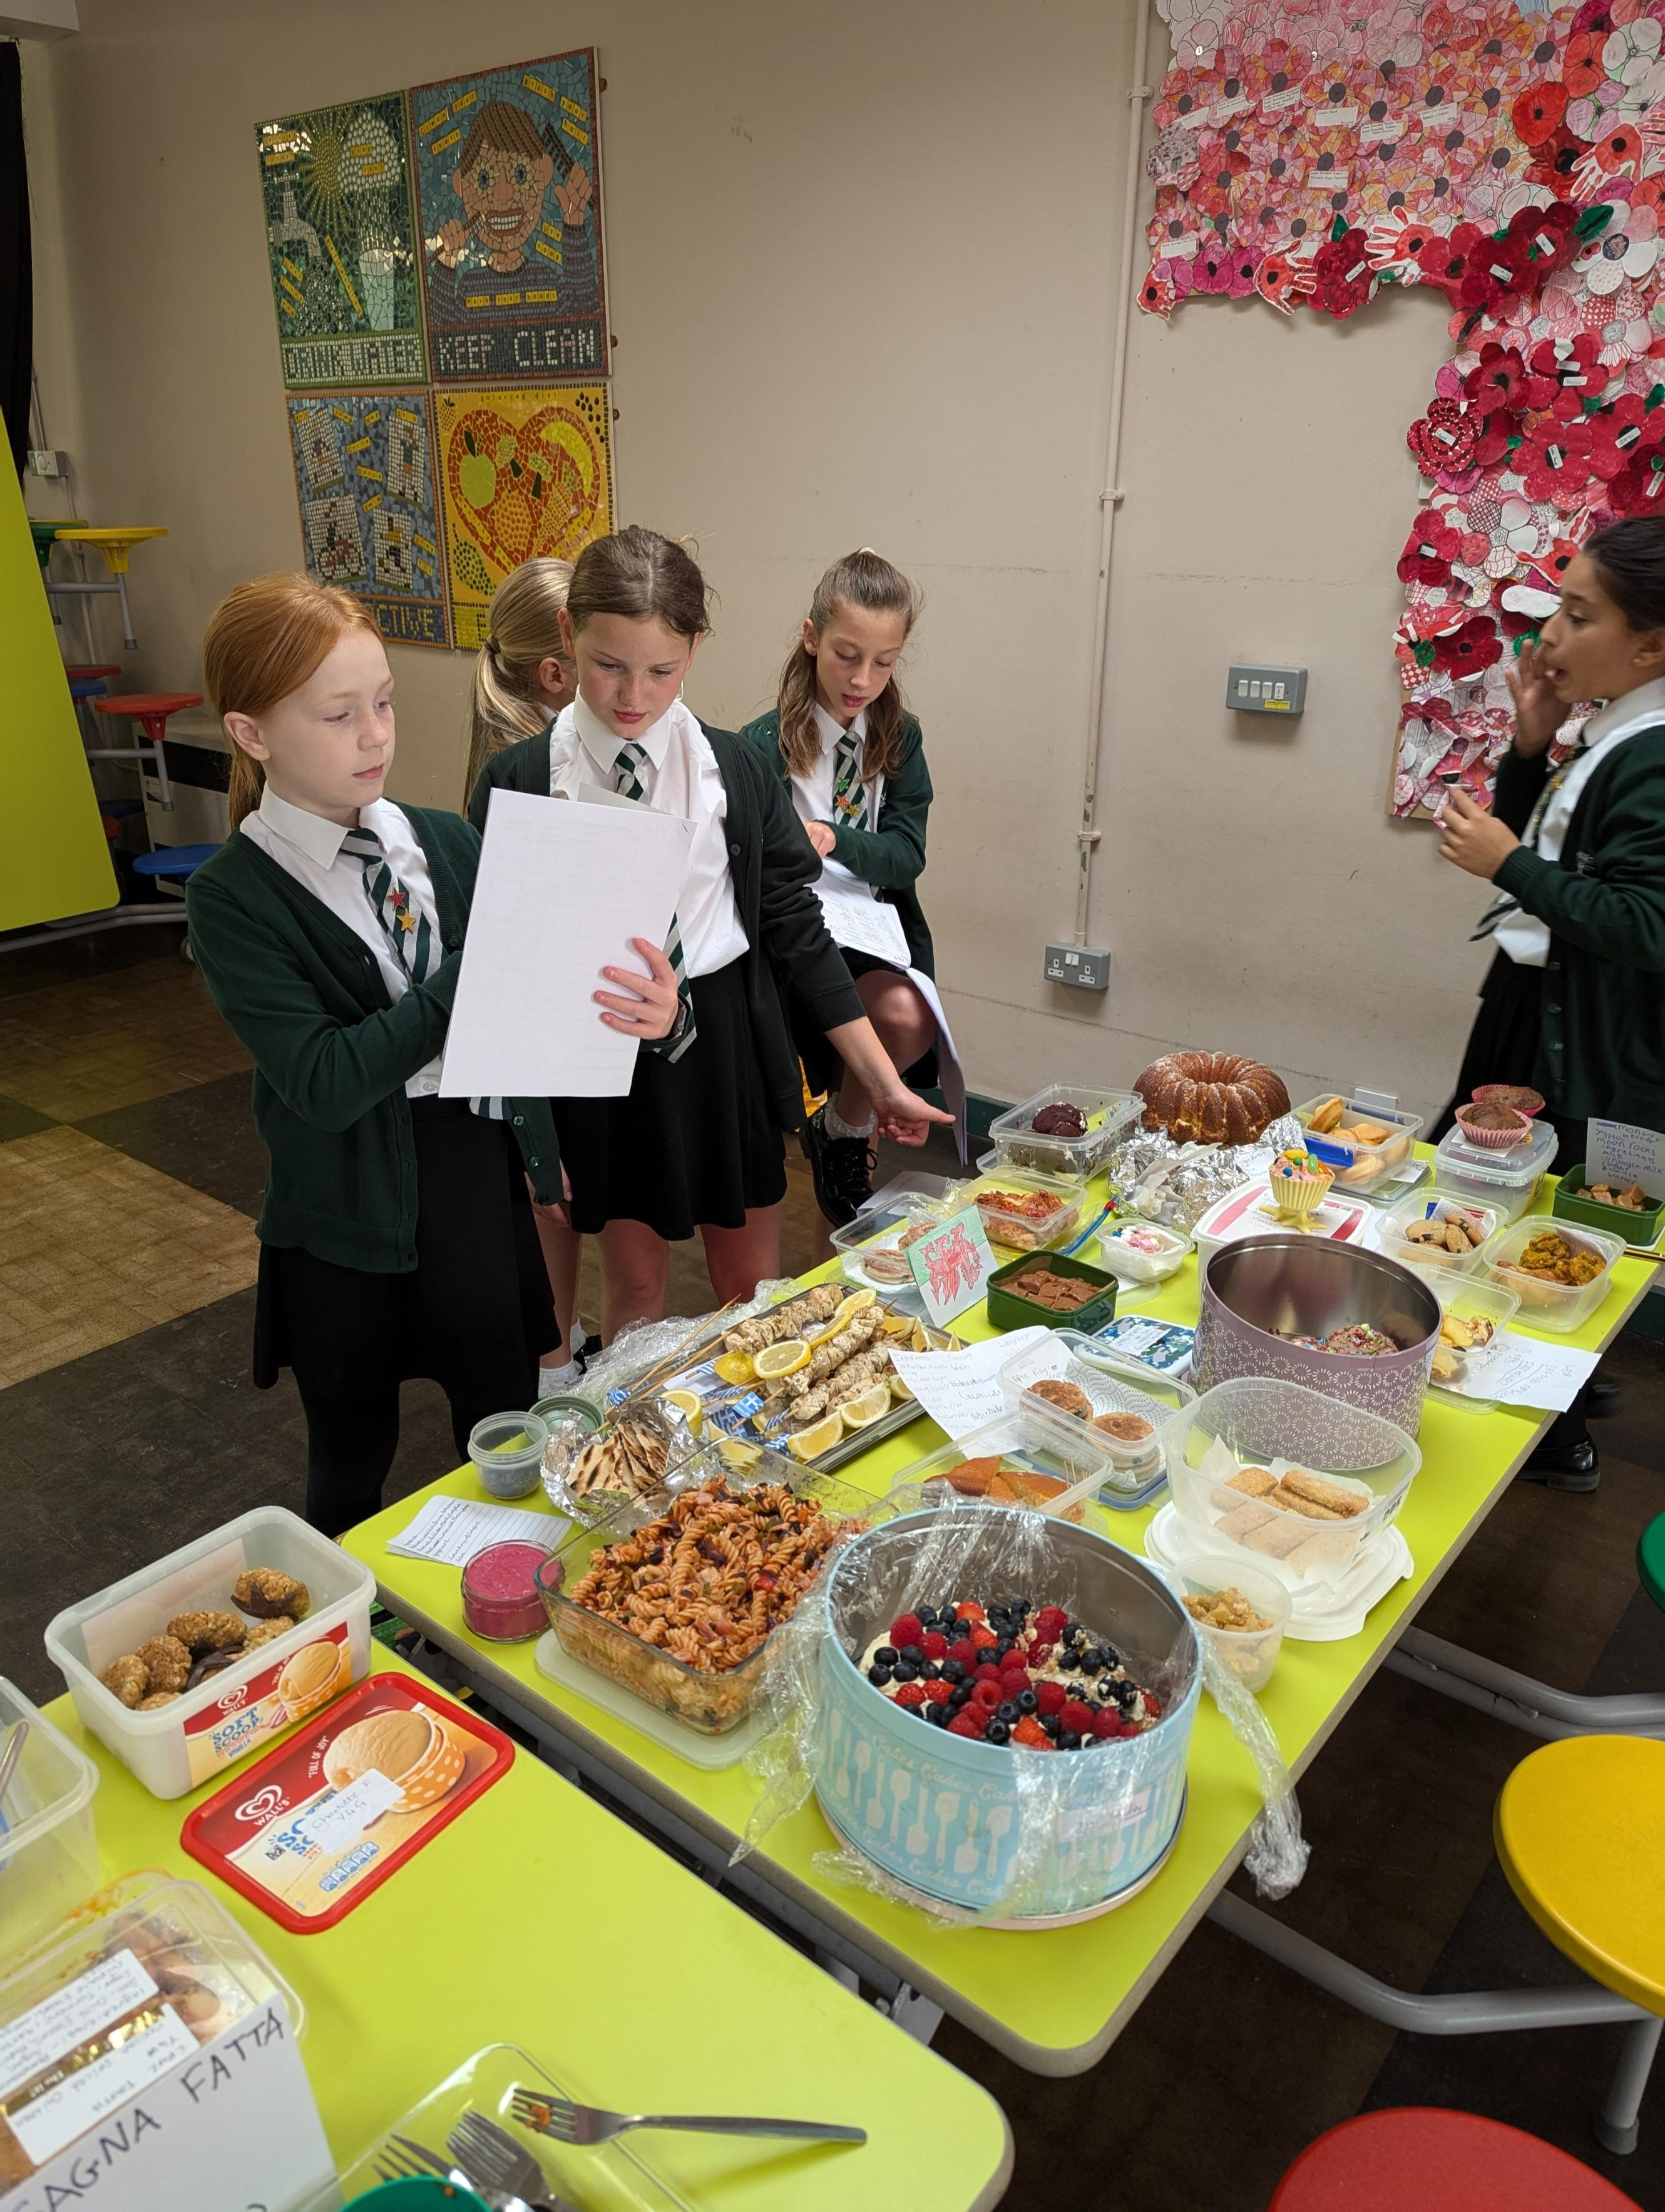
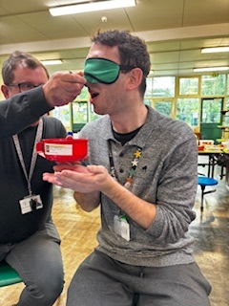
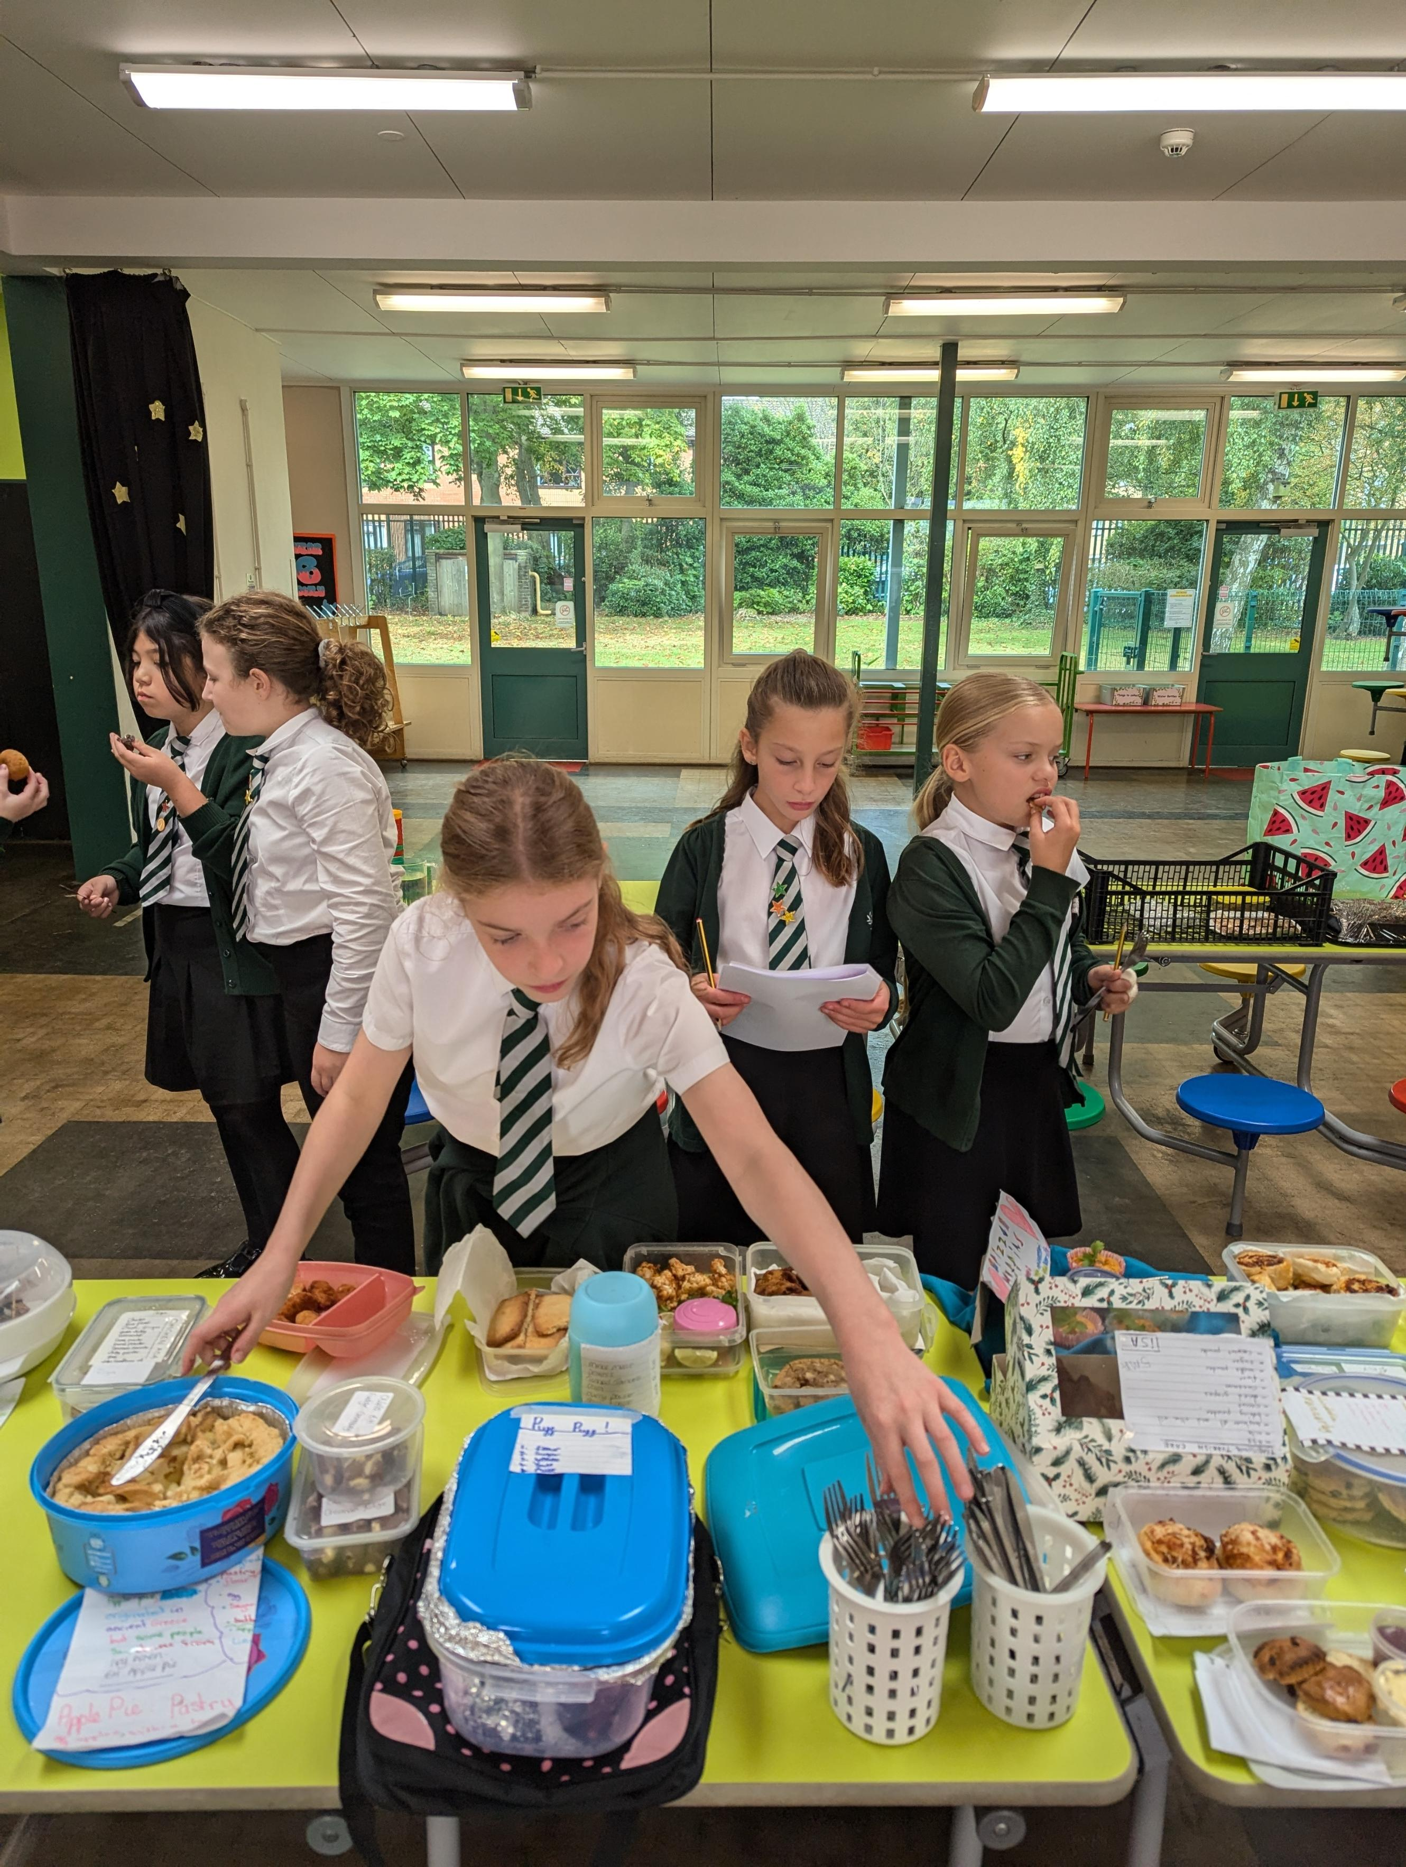
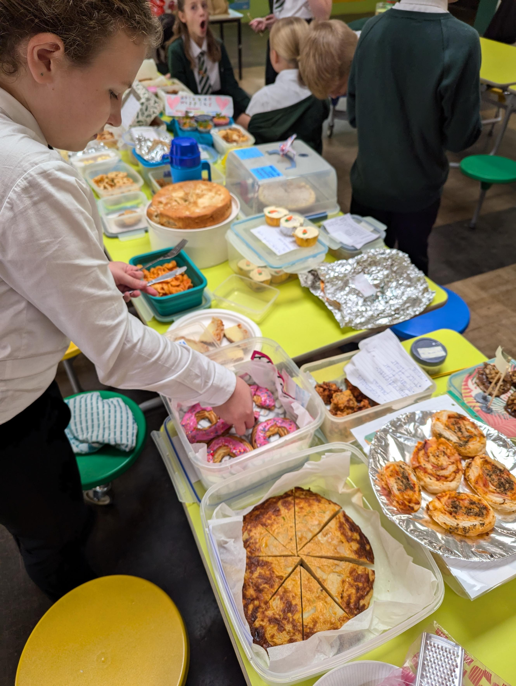
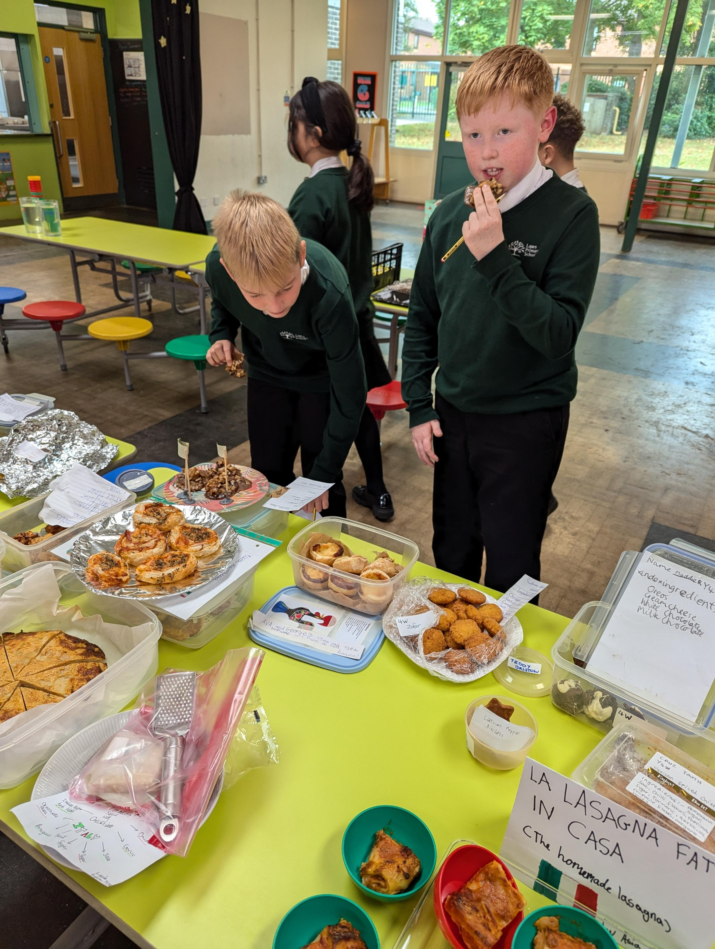
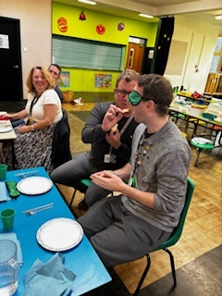
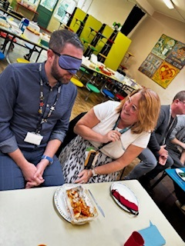
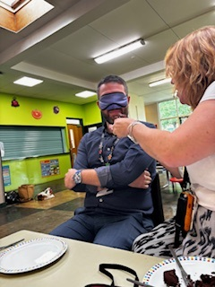
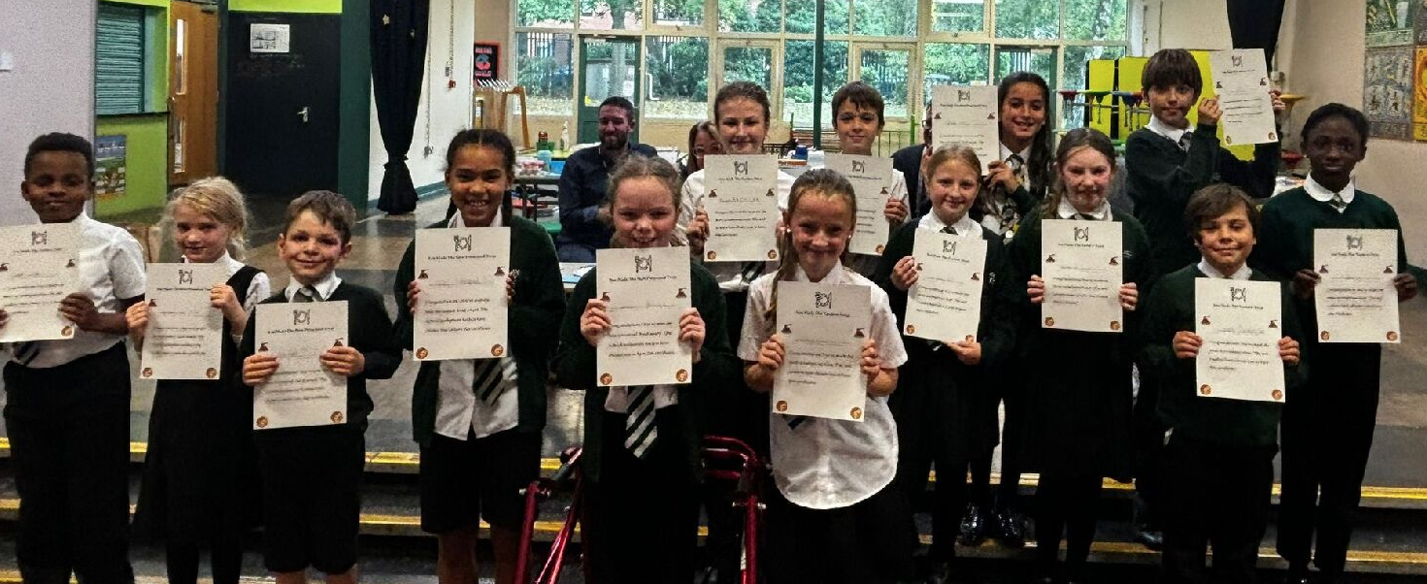
Languages Day
25.09.2024
International Cooking Competition!
A highlight of the day has got to be the International Cooking Competition!!
We had around 80 entries – children having cooked the most incredible dishes at home with their families. The variety was so impressive, from Chinese to Italian, to Thai, to Polish, to Russian! The Year 6 leaders really enjoyed trying all of the dishes brought in by KS2 students for the cookery competition and were proud to award certificates to the winners. It was wonderful to celebrate and embarce the cultural diversity I the school.
A highlight of the day for many was seeing Team Glutentag vs Team Molison's Marvellous Munchies in the tasting challenge competition. We are sorry that not every child had their dishes tried by the teachers , but they were willing!!
What did everyone think?
A lovely quote from Mateo in Year 1 "I know that song! Can I come to the front to sing with you?" Mateo then stood in front of all of KS1 in Spanish Sing Up and sang Veo Veo (I spy with my little eye) with Ms Harrison.
‘What a fantastic event….we need to do more and the children were fabulous, such fun!’ Miss Hendy
A huge thank you has to go to the Year 6 Language Leaders for their planning for this special event and their creative ideas, not forgetting their organisation on the day too.

