Slide 1

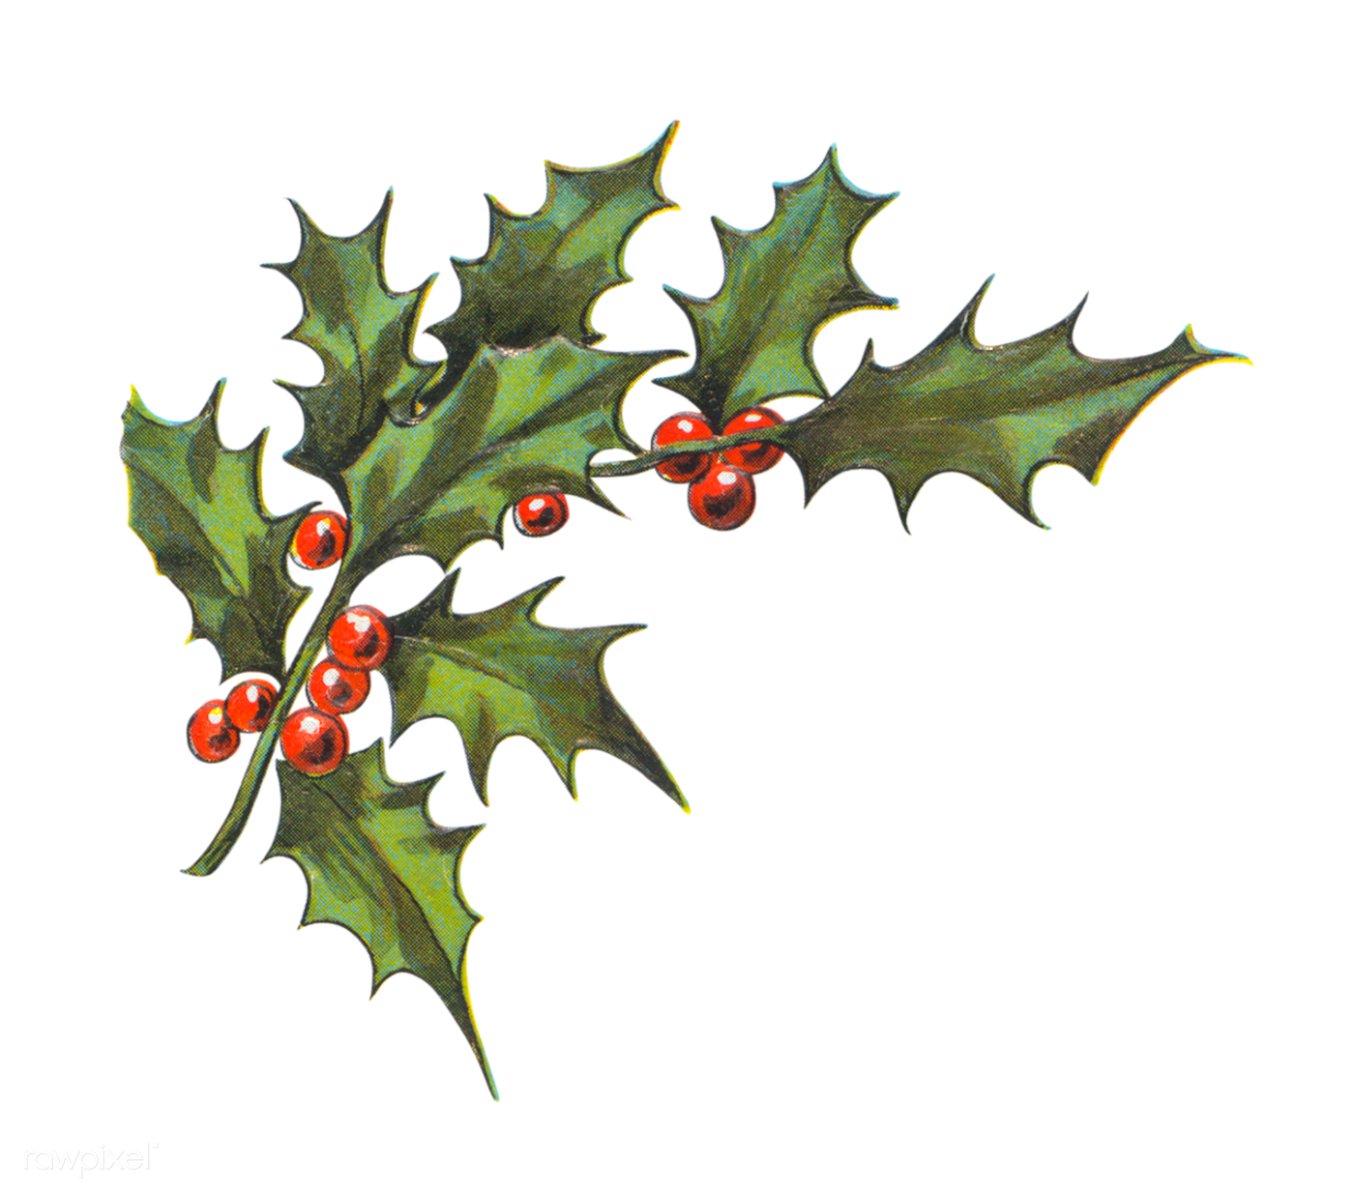
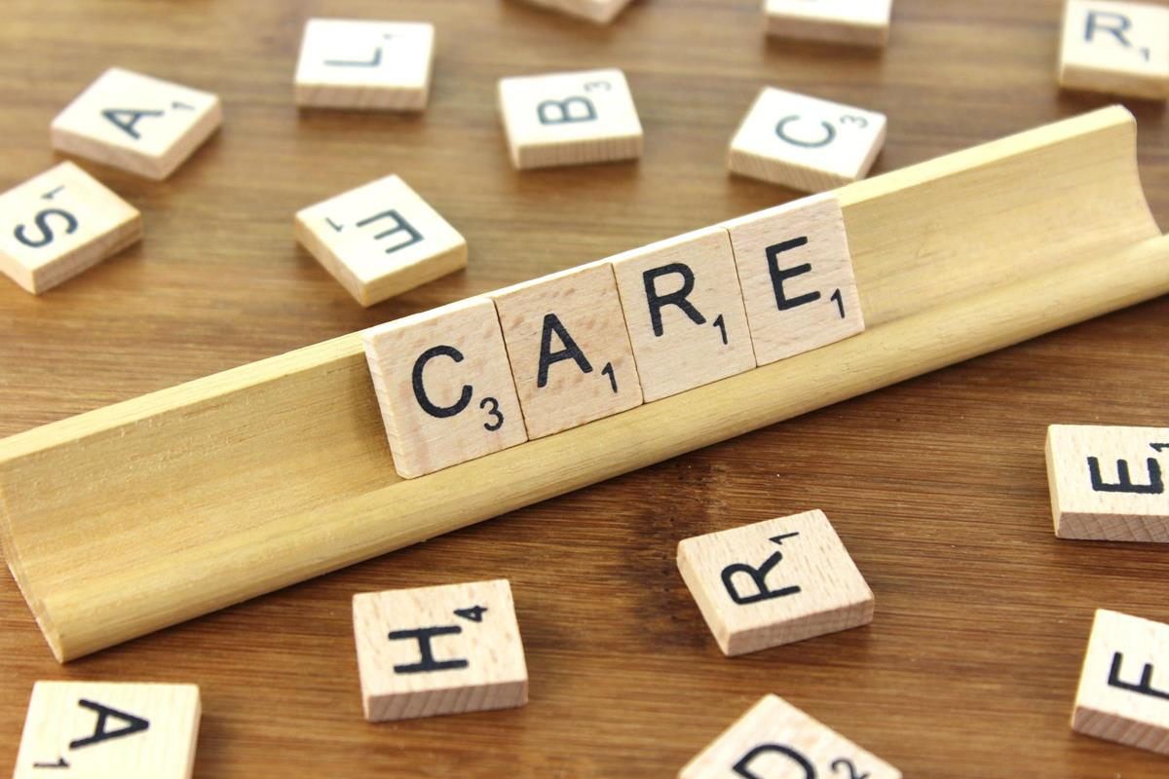
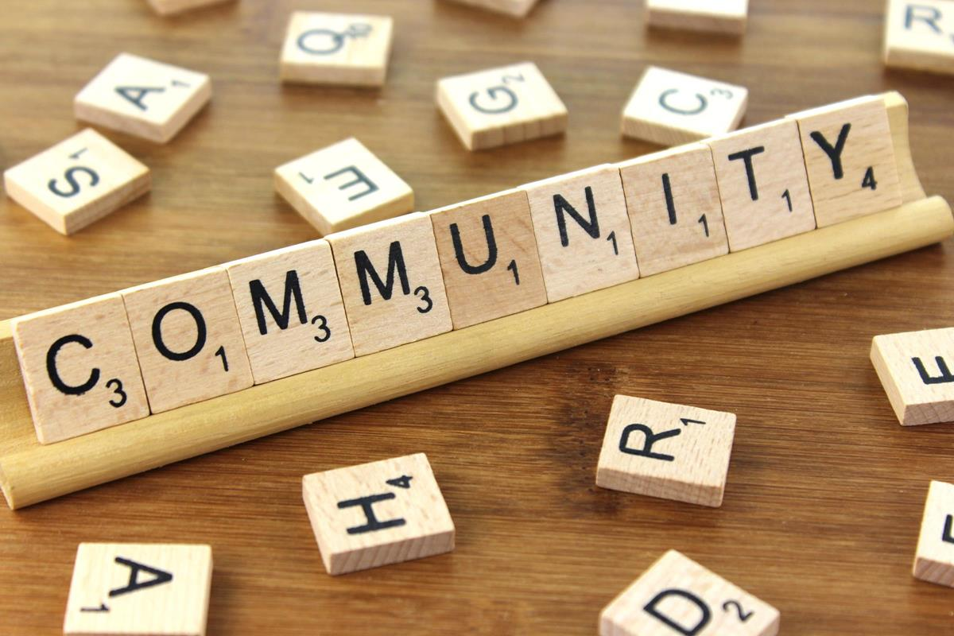
CARING FOR THE COMMUNITY CHALLENGE!
Hi children (and grown ups!)
This holiday challenge is one of my favourites….and I hope you understand why and join in!
At Lawn we demonstrate our values in lots of different ways and understand the importance of being a good citizen. So, we challenge you……
DO SOMETHING CARING, CONSIDERATE AND THOUGHTFUL WITHIN OUR COMMUNITY.
It could be…
Sending a home-made Christmas card to a care home
Baking a cake for an elderly neighbour
Sending home-made decorations to a local hospital
Helping at a charity event
Doing the shopping for someone who can’t
Donating your old toys to charity after Christmas
Carol Singing
I know you will have lots of fantastic ideas…. The small things care big gifts. Just remember to always check with your adult at home and ask for help if you need it.
All those who send in a picture to me on do-jo will receive a badge for their tie.
Have fun, and let’s make a difference!
Mrs Hambleton #empathy #responsibility #respect

