Slide 1
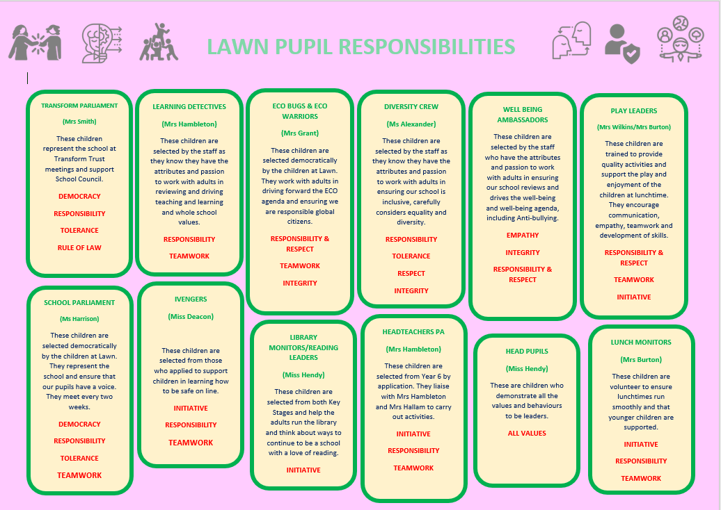
Summary: Pupil Leadership
‘We have many leadership roles like School Parliament and ECO bugs. This prepares us for if you wish to be involved in politics when you are older or understand climate change. You also need ambition and be persistent in reaching goals’
‘We have class council where you speak up and share ideas and use democracy and fairness – this teaches you what it is like to be a leader or be in charge!’
‘We have different duties to show that we are responsible and turn up to our shift and to make sure other people are responsible too’
‘Learning Detectives is a good way of children telling them and then they can speak to the senior leadership team’
‘As playground buddies we show a good example and are a role model to the younger children’
‘To be a good leader you need empathy, to be able to
listen to friends or people you team with, respect each others differences and help your peers learn’
‘You need tolerance, respect and responsibility….initiative and teamwork’
School Approach
Our values cover all aspects of pupils personal development and are the basis of all discussions with children. These values are lived-out by the whole community and are embedded within the fibre of the school. At Lawn Primary School, we see pupil leadership as a crucial part of developing as Global Citizens who will have a positive impact on society.
Our Values: Responsibility Respect Empathy Integrity
Initiative Creativity
Impact
% of pupils have a responsibility around school
% PP pupils have a responsibility
% SEND pupils have a responsibility
% EAL pupils have a responsibility
Pupils behaviour and values demonstrates their personal development to global citizens who have a positive impact
Pupils can articulate way they are leaders and the impact they can have
Pupils demonstrate leadership skills outside of school e.g. Care in the Community Project, Mrs Hambleton’s Challenges, Global Citizenship Awards
X Children have been awarded a Global Citizenship Award
Direct Impact on others: Bridge the Gap over £4000 raised.
ECO Impact in school: Increased re-cycling, reduced waste, reduced costs
Parliament: charity events
Learning Detectives – impact on Victoria Primary School, own environment
98% of KS2 pupils say that responsibility is encouraged

