Slide 1
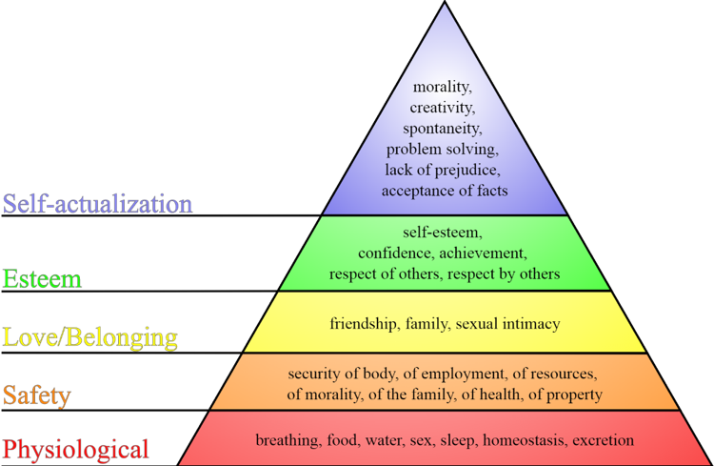
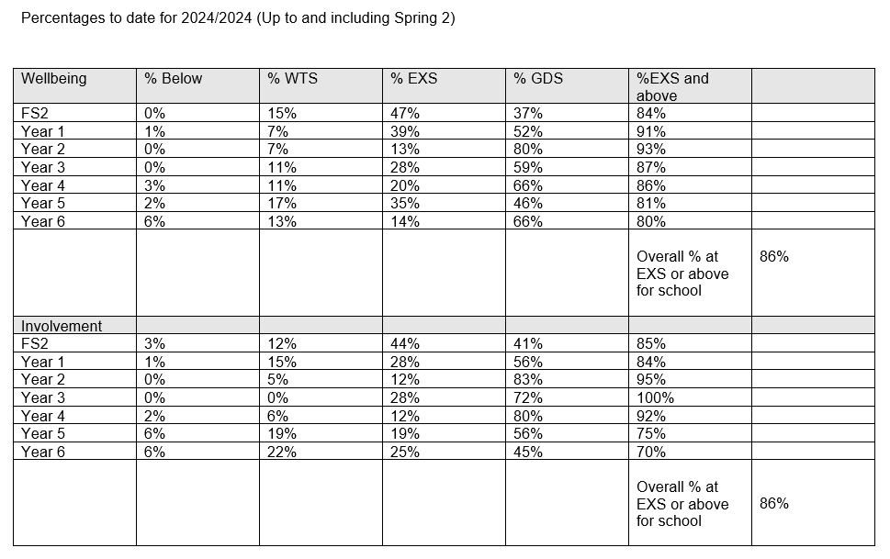
Summary: Mental Health & well being of pupils
‘We have PSHE lessons which teaches you about how to take care of yourself and others’
‘Sometimes we have Wellbeing Wednesday’s and we talk about it in collective worship’
PE helps us to stay mentally fit rather than being indoors all the time’
‘Teaches us to eat healthy helps our wellbeing’
‘Mrs O’Hare and Mrs Severn help us if we need additional support’
‘Our norms and values ensures we are healthy, happy and safe which helps our mental health’
‘Our worry boxes are checked daily – it is another way if you find it hard to say’
Universal Support
Use of a key adult
Safe spaces
Sensory breaks
Mindfullness activities
PSHE
Physical activity
Forest School
Pretend Play
Creative outlets
Gardening
Pupil responsibilities
Targeted Support
ELSA activities
Drawing and Talking
Emotions Coaching
Zones of Regulation
CBT based activities
Sensory Circuits
Sensory Integration
Lego Therapy
Social Stories
Specialist Support
Drawing and Talking
Art Therapist
Early Help/TAF
OT activities
Life Story work – Social Care
School Approach
Our values cover all aspects of mental health & wellbeing. These values are lived-out by the whole community and are embedded within the fibre of the school. Positive mental health and wellbeing is the core of healthy pupils and is a high priority for the whole school community. The school uses a relational, restorative approach to support wellbeing. The staff are all Trauma and Attachment Trained. Belonging is the key driver to wellbeing.
Wellbeing Leader/Mental Health Trained – Jo O’Hare
Mental Health Trained: Amy Williamson
ELSA: Jo O’Hare & Nicola Severn
Drawing and Talking: Jo O’Hare (advanced) & Nicola Severn
Support Available for pupils
Support at 3 tiers: Universal, Targeted, Specialist
SEMH team around the child meetings
Direct work with Learning Mentors
Direct work with ELSA
Referral to external professionals
Referral to Local Authority Services
SPOA referrals when mental health and wellbeing is linked to SEND
Parent support from Learning Mentor/ELSA/HT/SENDCO
Bridge the Gap – family support
Data
Data on Pupils wellbeing is collected three times a year through the Leuvan’s Scale. This is recording on INSIGHT to enable staff to monitor and analyse patterns and groups across school.
Strengths and Difficulties Questionnaire completed to analyse area of concern and select appropriate support.
Impact
Link between sense of belonging and attendance – 90% families feel valued, 98% feel valued as an individual, 97% feel included.
98% of pupils say the school encourages them to consider their mental health and wellbeing
98% feel safe
100% know there is a adult to talk to in school with worries
Significant neurodiversity is very well supported across school.
No significant behaviours – no exclusions – referrals to Transform Enhanced Panel
Other schools offered support from Lawn within the Trust.

