Slide 1

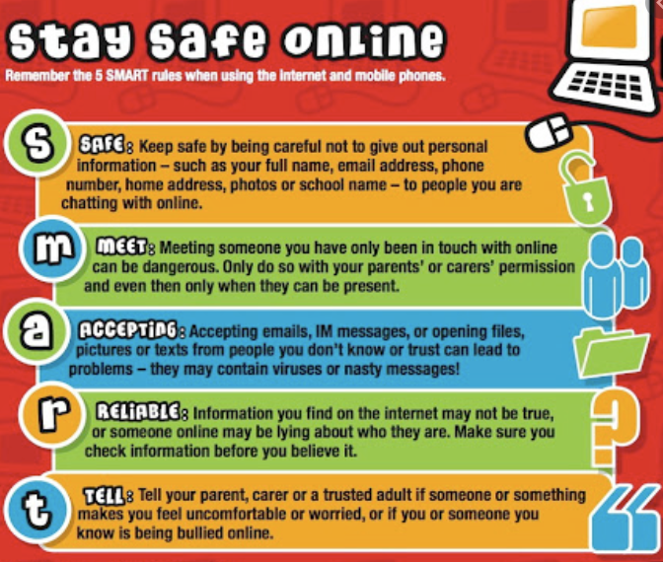
Lawn Primary School – How we keep you safe
At Lawn Primary School we put keeping you safe at the centre of everything!
YEAR 4
E-Safety- In Computing, we explore how to keep ourselves safe online including not sharing any personal information with others and the importance of speaking to a trusted adult if you see something that makes you feel uncomfortable.
Anti-bullying Week- In November, we spend a whole week learning about and discussing the various different types of bullying that exist. We learn what to do if we or someone we know is being bullied as well as the impact of bullying on a person’s mental health.
Wellbeing Wednesdays- In Year 4, we have ‘Wellbeing Wednesdays’ where we can discuss feelings and ideas and learn wellbeing techniques.
We have lots of fun with our learning.
We know that we can talk to the adults in the school if we are upset or have worries.
Who are my trusted people?
Keeping yourself safe around people you don’t know.

Slide 2
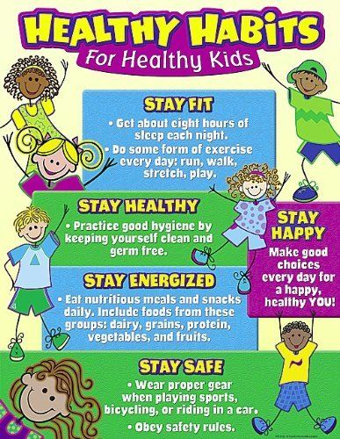
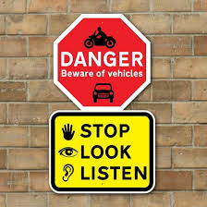
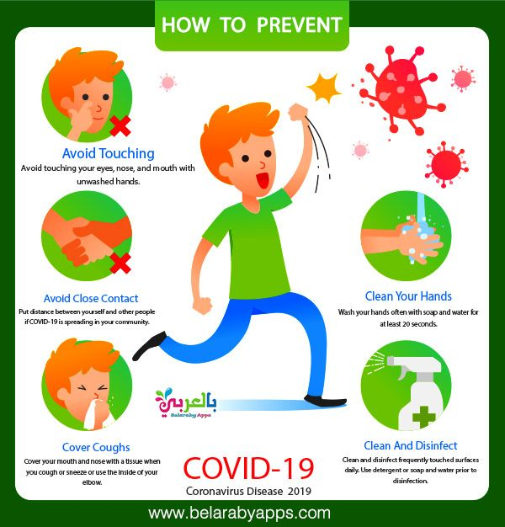
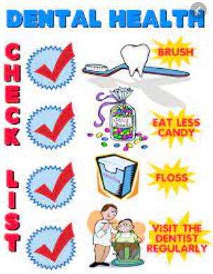
Lawn Primary School – How we keep you safe
At Lawn Primary School we put keeping you safe at the centre of everything.
YEAR 4
In year 4, we learn to keep healthy in our: PE lessons, where we learn how to keep active, science, where we learn how to keep teeth clean, and design and technology, where we learn about the importance of a healthy diet.
In Year 4, we cross the road with an adult.
We always stop, look and listen.
We think about safe places to cross the road.
We walk carefully across the road when it is safe.

