Slide 1

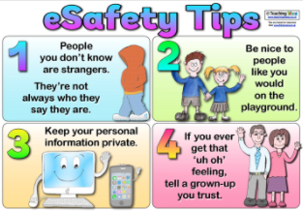
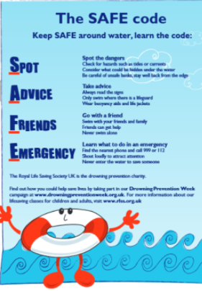
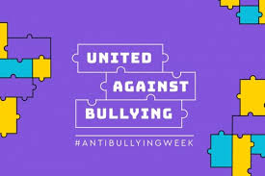
Lawn Primary School – How we keep you safe
At Lawn Primary School we put keeping you safe at the centre of everything.
YEAR 3
Online Safety | Water Safety | Anti-Bullying
In our Y3 online safety lessons we think about the ways in which we can keep ourselves safe when we use the internet. We are kind, don’t share personal information and ask adults to help us use games and programs online.
In Year 3, we are kind to each other and look out for friends who might need our help. We include each other in our games.
We like that we are all different and respect each others ideas and feelings.
If someone hurts us we talk to an adult.
We always say sorry if we have hurt someone.
In Year 3 we attend swimming lessons with school. As part of our swimming lessons we talk about water safety and learn how to help others if they are in danger.

Slide 2
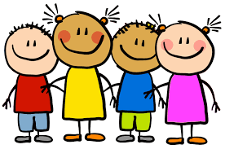
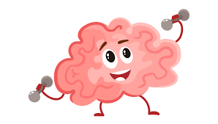
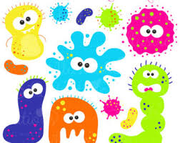
Lawn Primary School – How we keep you safe
At Lawn Primary School we put keeping you safe at the centre of everything.
YEAR 3
Body Safety | Mental Wellbeing | Covid-19 and Health
In Year 3, we wash our hands and use hand sanitiser regularly.
We cover our mouth if we cough and use tissues to ‘catch it, kill it, bin it’.
We open the windows to allow fresh air into the classroom.
We drink clean, fresh water.
We keep our classroom tidy so it can be cleaned easily.
We learn about the importance of a balanced diet, exercise and good hygiene.
In Year 3, we talk about our bodies and the differences between ourselves and others. We learn about personal space and the physical warning signs when a person feels uncomfortable. We think about why is it important to respect someone’s personal space.
In Year 3, we have ‘Wellbeing Wednesdays’ where we can discuss feelings and ideas and learn wellbeing techniques.
We learn how we can help each other and ourselves with our feelings. We know that we can talk to the adults in the school if we are upset or have worries.

