Slide 1





Lawn Primary School – How we keep you safe
At Lawn Primary School we put keeping you safe at the centre of everything.
FS2
Online Safety | Road Safety | Anti-Bullying
Smartie the Penguin helps us remember how to stay safe when we are online.
Before you tap and click…
You need to stop and think…
And TELL someone!
In FS2, we cross the road with an adult.
We always stop, look and listen.
We think about safe places to cross the road.
We walk carefully across the road when it is safe.
In FS2, we use kind hands and kind words.
We include each other in our games.
We like that we are all different.
If someone hurts us we talk to an adult.
We always say sorry if we have hurt someone.
In FS2, we are kind, don’t share personal information and ask adults to help us use games and programs online.

Slide 2

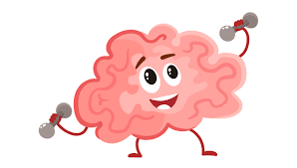

Lawn Primary School – How we keep you safe
At Lawn Primary School we put keeping you safe at the centre of everything.
FS2
Body Safety | Mental Wellbeing | Covid-19 and Health
In FS2, we wear underwear to cover our private parts.
We close the door when we use the toilet.
We use the proper names for our private parts.
We do not have to be touched, hugged or kissed by anyone if we are not comfortable.
In FS2, we have ‘Wellbeing Wednesdays’ where we can discuss feelings and ideas and learn wellbeing techniques.
We have lots of fun with our learning.
We know that we can talk to the adults in the school if we are upset or have worries.
In FS2, we wash our hands and use hand sanitiser regularly.
We cover our mouth if we cough.
We use tissues to ‘catch it, kill it, bin it’.
We have fresh air in the classroom.
We eat lots of fruit.
We drink clean water.
We keep our classroom tidy so it can be cleaned easily.

