Slide 1


Understanding
Autism & ADHD

Slide 2
Contents
Part 1: What is neurodiversity?
Part 2: Legal issues surrounding neurodiversity
in the workplace; research and securing
support for employees.
Part 3: Understanding specific conditions:
Autism and ADHD
Part 4: Reflection
Part 5: Planning next steps

Slide 3


Part 1: Overview
What is ‘Neurodiversity’?

Slide 4
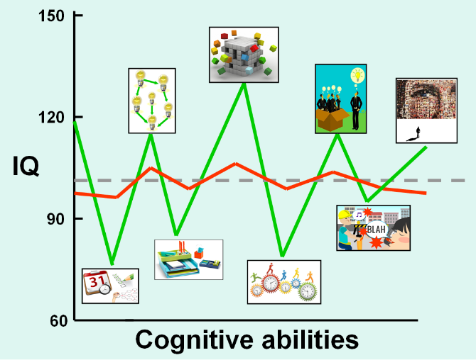
Neurodiverse people have abilities which are ‘out of balance’, with significant differences between their strengths and difficulties.
Neurotypical individuals (red line) have similar abilities in all areas.

Slide 5
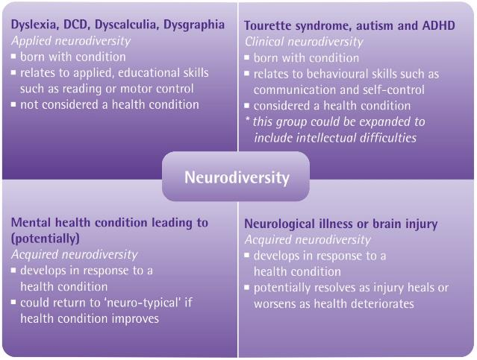
What is Neurodiversity?
Recent research has grouped these neurodiverse conditions into four key categories:
From Psychology at work: Improving wellbeing and productivity in the workplace, Weinberg, A & Doyle, N, 2017.

Slide 6

Overlapping Neurodiverse Conditions
Dyspraxia
(Now known as Developmental
Co-ordination Disorder (DCD)
Innovation
Rapport
Awareness of others
Dyscalculia
Intuition
Verbal communication
Dyslexia
Visual thinking
Creative ability
Connecting ideas
Neurodiversity
Evolution has created
specialist thinkers to
bring a variety of
expertise to
humanity.
Sound processing
3D mechanical ability
ASC
Autistic Spectrum Disorder
Concentration
Fine detail processing
Sequencing
ADHD
Attention Deficit-
Hyperactivity Disorder
Creative ability
Novel thinking
Energy and passion
ADHD
Attention Deficit
Hyperactivity Disorder
Creative ability
Novel thinking
Energy & passion
Tourette’s
Ideas
Creative ability
Cognitive control
Based on the highly original work of Mary Colley, DANDA

Slide 7

Part 2: The Legal Issues Surrounding Neurodiversity in the Workplace

Slide 8
What are the legal issues surrounding neurodiversity in the workplace?
“A person has a disability if she or he has a physical or mental impairment that has substantial and long term (12 months+) adverse effect on his or her ability to carry out normal day-to-day activities.”
Equality Act 2010

Slide 9
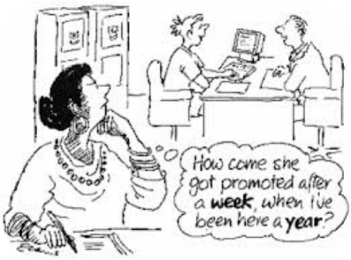
Direct Discrimination
Making assumptions about capability and treating differently as a result
Failure to make reasonable adjustments
Victimisation
Harassment
9

Slide 10
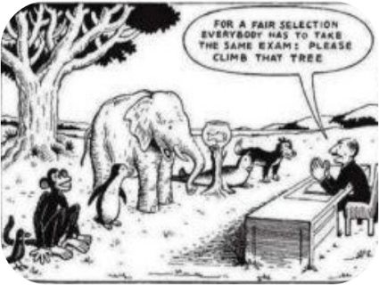
Indirect Discrimination
By treating all people the same, you may inadvertently be discriminating
As an employer you are still accountable for this
10

Slide 11

https://www.bps.org.uk/news-and-policy/psychology-work-bps-report-launched-today

Slide 12
Getting Support
Getting a workplace needs assessment (free through Access to work or some choose full private assessment). This will give advice on:
    Assistive technology
    Coaching
    Informal adjustments
Use a free online tool to find out your strengths and difficulties and strategies that might work for you. We have a free strategy profiler on our website: https://screening.geniuswithin.co.uk/index.php/dyslexiatest/indexhttps://screening.geniuswithin.co.uk/index.php/dyslexiatest/index
https://www.gov.uk/access-to-work

Slide 13

Part 3: Understanding
Specific Conditions: ADHD

Slide 14
What is ADHD?
ADHD stands for Attention Deficit Hyperactivity Disorder.
ADHD is more an inability to regulate attention rather than a simple lack of ability to attend to a task.
ADHD can occur in people of any intellectual ability.

Slide 15
Where does ADHD come from?
Still limited research and evidence as to what promotes the behaviours.
Most common theory = lack of dopamine the brain produces.
  Dopamine is one of the chemicals in the brain that deals with pleasure.
  A lack of dopamine means an individual will require more of something else in order to feel the same amount of pleasure, as someone who has normal levels of dopamine.
Also evidence of less activity in pre-frontal cortex governing working memory, inhibitions but higher levels of alertness.

Slide 16
Core diagnostic symptoms of ADHD
Distractibility
Difficulty attending to a single task when faced with other things in their environment competing for their attention
Impulsiveness
Difficulty with being patient and delaying gratification
Restlessness
Find it hard to stay still, constantly playing with things around them or fidgeting
Internal restlessness = bored easily, constantly searching for mental stimulation
Hyperfocus
Ability to focus very intently on things that do interest them and will often become oblivious to what's around them
N.B. note the very negative focus, based on social norms of stillness, focus and patience

Slide 17

How some people describe having ADHD
“Being able to tune into 12 different radio channels all at the same time, where you are able to hear the noise from each program and can't tune out all of the others and focus on one.”
“Driving in the rain with bad windshield wipers. The windshield gets smudged and blurred as you’re speeding along, but you don’t slow down, You keep driving trying your best to see.”

Slide 18
What might an ADHD profile look like?
Strengths
Verbal Comprehension
Perceptual Organisation
Weaknesses
Working Memory
Processing Speed

Slide 19
ADHD: Common Strengths & Difficulties
 | Difficulty | Strength
ADHD: Prevalence up to 4% | Time management Concentration, attention and self-regulation difficulties Insomnia, depression, injury and absence Maintaining employment Difficulty with team work | Creative thinking Visual spatial reasoning ability Hyper-focus, passion and courage.

Slide 20
Supporting Individuals with ADHD
Medical
Keep in contact with medical professionals, medication might be suitable
Strategies
Memory skills
Ergonomics
When writing or reading sit/stand where there are the least distractions to reduce background noise
Pay attention to diet and rest
Keep an exercise and rest balance
Learn to recognize sensory triggers
Organisational skills – lists and colour are a great help
Timekeeping
Communication skills
Separating emotional inference from what is seen or heard
Work to strengths
Create a breaks routine and keep to it
Consider a dual screen to keep multiple screens open when doing computer work
Stand and change position frequently (standing desks are great)
Consider a weighted blanket to help concentration

Slide 21
Supporting Individuals with ADHD
Communication
Use bullet points in written communication
Meetings
Give extra time before and after to review where possible
Awareness
Build in frequent breaks
Be specific with instructions
Use feedback which separates what was seen and heard from the interpretation of this
Accept emails may appear short – give feedback but do not take it personally
Give alternative to group meetings – update via 1:1
Follow up requests in meetings with written emails or notes
Give agenda to every meeting
Issue documents before meetings to allow focus and preparation
Set time limits – do not use ‘Give it to me when you are ready’
Take a holistic view – expect highs and lows, totally focused concentration and times of complete lack of focus
Listen to the individual, ask them what they would like to have happen

Slide 22

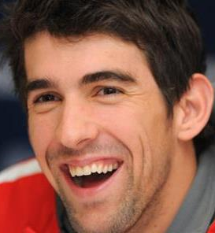

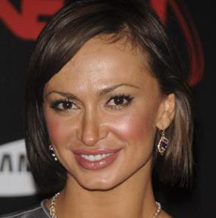


Well-known personalities who have ADHD
Michael Phelps
Solange Knowles
Jim Carrey
Karina Smirnoff
Will Smith
Justin Timberlake

Slide 23
Part 3b: Understanding
Specific Conditions: ASC

Slide 24
What is ASC?
ASC is something a person is born with.
Women and men present very differently – the ratio is approximately 1:4.
There is research to suggest that there is a genetic link from parent to child.
There is research to suggest that people with ASC have very highly developed sensory awareness but less executive function processing.
Autism does not come from neglect or injury.

Slide 25
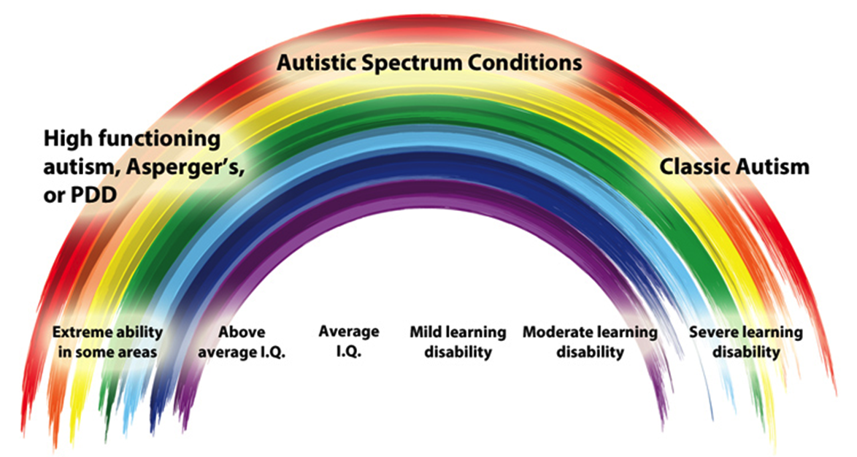
What is ASC?
Individuals with Autistic Spectrum Conditions demonstrate a wide spectrum of ability.

Slide 26

Fiction
Adults with ASC are obsessed with order
All people with ASC cannot start or sustain a relationship
People with ASC don’t have emotions
People with ASC are geniuses and have huge talents
You can only be diagnosed with ASC as a child
All people with autism are good at maths, art and music

Slide 27

Fact
There are around 700,000 people in the UK living with autism
Approximately 50% of autistic people may have a learning disability. The other 50% do not.
Autism is a hidden disability - you can't always tell if someone has it
Only 16% of autistic adults in the UK are in full-time paid employment

Slide 28
Core diagnostic symptoms of ASC
Social Communication
Issues with reading social cues, facial expressions
Volume of what is said may be excessive or ill timed
Social Imagination
Problems with not understanding the impact of what they may
Say in the moment in that it may offend or seem to be abrupt.
Social Interaction
Problems with initiating conversations
Socialisation is often exhausting.
Flexibility of thought
Once an idea about a subject or a person has been formed, it
May be difficult to sway an individual from this train of thought.
Sensory Processing
Sensitivity to smell, heat, images, sound and more
Difficulties concentrating
N.B. again note the very negative focus, based on cultural norms of social interaction and understanding nuanced social rules

Slide 29
ASC: Common Strengths & Difficulties
 | Difficulty | Strength
Autism Prevalence up to 1.5 % | Time management Concentration and coping with more than one task Social and communication difficulties Need for routine | Memory ability, and other ‘specialist individual skills’ including reading, drawing, music and computation Innovative thinking and detail observation

Slide 30
Supporting Individuals with Autism
Medical
Keep in contact with medical professionals, support with sleep and anxiety might be necessary
Strategies
Memory skills
Ergonomics
Know your sensory triggers – position yourself where you can feel calm and not overwhelmed
Pay attention to diet and rest
Keep an exercise and rest balance
Organisational skills – lists and colour are a great help
Timekeeping
Communication skills
Ask for clarification and examples
Work to strengths
Create a breaks routine and keep to it
Identify break out spaces for moments of overwhelm

Slide 31
Supporting Individuals with Autism
Communication
Meetings
Give extra time before and after to review materials where possible
Awareness
Be really aware of noise, light, smell, temperature and colour – these things can overwhelm
Be specific and precise with instructions
Use feedback which separates what was seen and heard from the interpretation of this
Give advance notice or identify when giving an instruction that might not be expected
Give alternative to group meetings – update via 1:1
Follow up requests in meetings with written emails or notes
Give agenda to every meeting, identify and acknowledge when deviating from it
Allow the individual to have break out space and don’t interrupt when this is being use unless invited and pre-agreed
Listen to the individual, ask them what they would like to have happen
Explain hidden rules, don’t be embarrassed to check understanding of things you might feel are obvious
Provide a buddy of mentor if possible

Slide 32


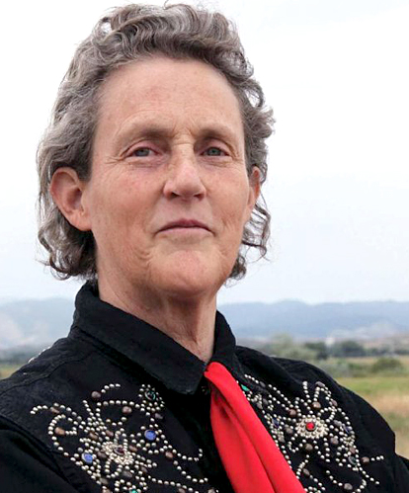
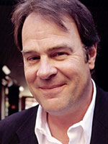
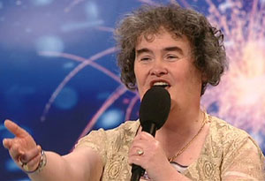
Well-known Personalities who have ASC
Courtney Love
Chris Packham
Temple Grandin
32
Dan Aykroyd
Susan Boyle

Slide 33

We are all different ….
…. so the best support is individualised.

Slide 34
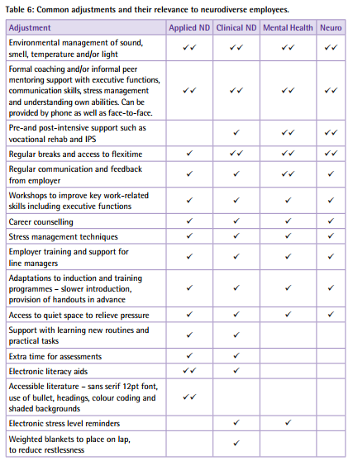
Common Adjustments and their relevance to neurodiverse employees
From Psychology at work: Improving wellbeing and productivity in the workplace, Weinberg, A & Doyle, N, 2017.

Slide 35

Part 4: Reflection

Slide 36
REFLECTION
1. What are you doing well to make your workplace inclusive
for neurodiverse individuals?
  What do you see and hear to know this?
2. What are you not doing so well?
  What do you see and hear to know this?
3. What could you do better?
  What will you see and hear when you have achieved this?

Slide 37

Part 5: Planning next steps

Slide 38
A social enterprise supporting people with neurodiverse conditions.
PLANNING NEXT STEPS
What three things can you do now that will make your
workplace more inclusive?
  What could you do more of?
  What could you do less of?
  What could you do differently?

Slide 39

A social enterprise supporting people with neurodiverse conditions.
https://www.geniuswithin.co.uk

Slide 40
For more information, contact:
Email: office@geniuswithin.co.uk
Tel: 01273 890502
Or visit our website: https://www.geniuswithin.co.uk

