Slide 1
Talk is essential to human development and relationships.
‘Talking and listening to children does lots of important things. It improves your bond with them, and encourages them to listen to you.
It helps them to form relationships and to build self-esteem.’
Healthy Families
Young people with poor communication skills are one and a half times more likely to have mental health difficulties…’
Communication Trust 2017, Talking About a Generation

Slide 2

Our vision for all our pupils:
To be well-prepared for their lives as active global citizens in the 21st century
To be confident communicators who can work successfully with others – this means they need to develop listening and speaking
To be able to make their thoughts and feelings understood by other children and adults, in a range of circumstances

Slide 3





Five Reasons That Talk Is Critical to Teaching and Learning:
Talk can reveal understanding, misunderstanding and misconception
Talk supports robust learning by boosting memory
Talk supports deeper reasoning
Talk supports language development
Talk supports development of social skills
Notes:
Remember too that talk reduces cognitive load and enables and empowers co-creation of knowledge and understanding

Slide 4
In addition…
We know that quality talk underpins effective thinking, reasoning and writing, but getting good at talk takes practice!
We want all of our children to be inquisitive and interested in the world around them, and actively engaged in all elements of school life. This means they should be asking lots of questions and doing lots of talking, having opinions and possibly changing them as they gather information and learn more
Try to make talk about what children know or have experienced– it’s hard for them to talk about something we don’t know or haven’t done/experienced
Everything we do is a model, so what talk are they seeing and hearing?
We need to be clear about language – when we say ‘chat’, what do they picture? Do they understand what ‘conversation’ means?

Slide 5
Have a quick think about the talk that your child sees/takes part in:
Where do children see or engage with talk?
How do they engage?
Who is doing the talking?
How are we modelling good listening?
How do they know what conversation ‘looks’ like?

Slide 6
<iframe width="683" height="384" src="https://www.youtube.com/embed/lih0Z2IbIUQ" title="Talking Twin Babies - PART 1 - OFFICIAL VIDEO" frameborder="0" allow="accelerometer; autoplay; clipboard-write; encrypted-media; gyroscope; picture-in-picture; web-share" allowfullscreen></iframe>
We all know that children pick things up from a very young age.
This incudes talk, conversation and how we engage with others.
Here is a little clip to illustrate this.
https://youtu.be/lih0Z2IbIUQ

Slide 7


Conversations with children help them to develop thinking, listening and learning skills.
What are you going to do today?
Asking open questions helps to make children think.
Recalling develops memory.
How many sounds can you remember?
Encouraging children’s questions develops their curiosity and active engagement.
Talking develops vocabulary.
That’s a new word, I think she means …
When you were a child, did you have cars? What did you eat?

Slide 8
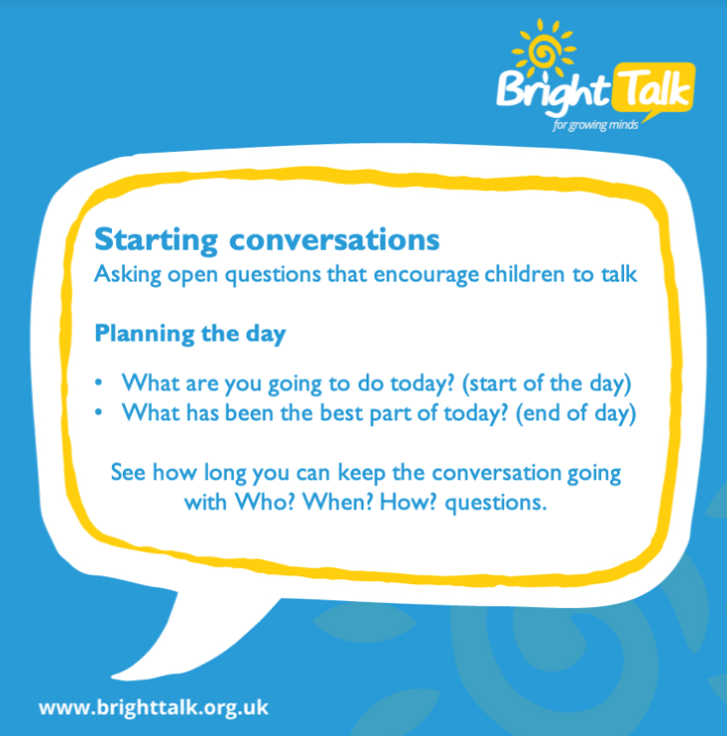
Let’s give it a go…
Consider wait time – children will probably need some thinking time before they are ready to answer
Encourage them to ask you about your day too, but try to make it so that you’re both participating equally. It is likely that the conversation will develop beyond the original subject!

Slide 9
Adult Role:
Supporting the development of children’s talk- you may have to encourage them to give answers or input that keep the conversation going as this skill improves with practice
Suggesting topics to talk about – start off with things are going to be interesting to the child or that they will know about
Prompting children to answer – if they are struggling, can you find a different way to ask the same question?
Remember to give them thinking time, and time to articulate their thoughts and opinions without interruption
Encourage them to ask questions themselves and explain their thinking
* This enables you to identify misconception and misunderstanding

Slide 10
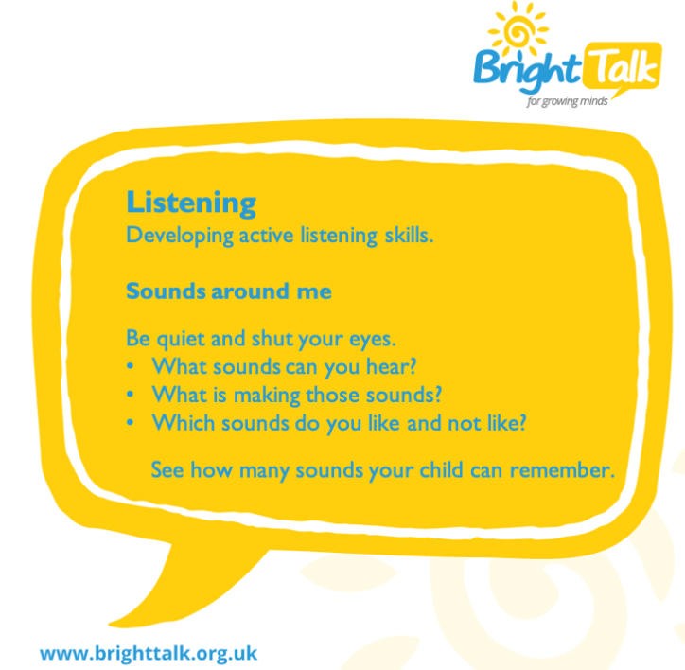
Extend the task by asking questions eg are you both hearing the same sounds or are you picking up different things?
If you can hear sirens, what might be happening?
If you can hear birds, what does that tell you (eg time of day)
Noise of vehicles – can you tell what kind of vehicle from the noise?
This is a lovely activity that can generate lots of talk, reasoning and and learning

Slide 11
Communication tips for parents and carers
Talk in your daily activities. Give your child a role to play in daily activities such as cleaning, shopping, preparing, cooking, setting the table, exercising, making the bed, etc.
Encourage discussion at mealtimes. Ask children how they are feeling; what they are doing; talk about favourite programmes, books, games, celebrations, places, etc.
Make time to listen when a child is talking. Show that you are listening by stopping what you are doing and making eye contact. Give time for your child to sort out ideas and words before you say anything
Provide good examples of language. Speak in full sentences as often as possible. If a child makes a mistake repeat the idea back to them, but reword it into the correct sentence rather than correcting it
Encourage talk by showing interest. Say, ‘Tell me more about…” , “Really?” and “Go on…”

Slide 12
What will Bright Talk look like for parents and children:
A weekly task will be shared on Dojo.
Children will be encouraged to share their experiences and the information they’ve learned as a result of their Bright Talk activities at home.
There will be certain talk tasks that you and your children enjoy more than others – it is OK to have favourites and integrate them into your routines and talk at home
We would love to hear your feedback! How did you find the activities? Which worked well for you? Have you noticed a difference in your child’s talk and engagement in conversation? If so, what are the benefits you are seeing?
Please visit the Bright Talk Website for additional information: Ask about Bright Talk in your school

Slide 13
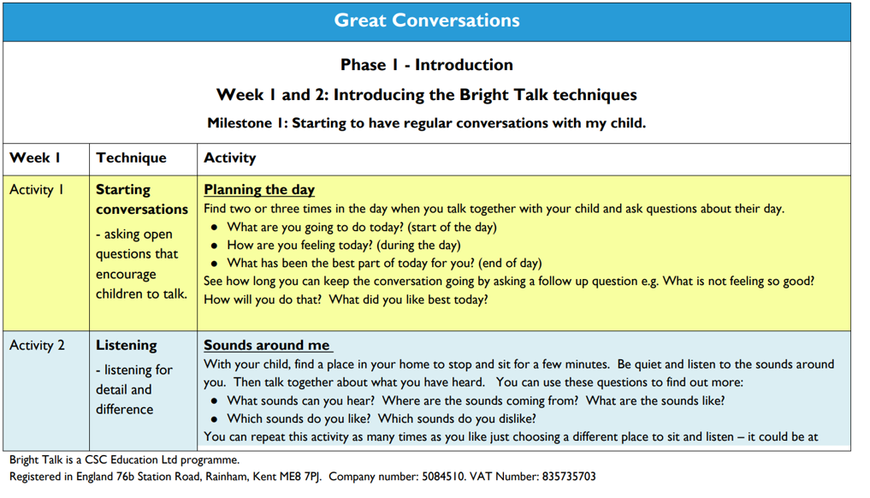
A sample of what the activities will look like.

Slide 14
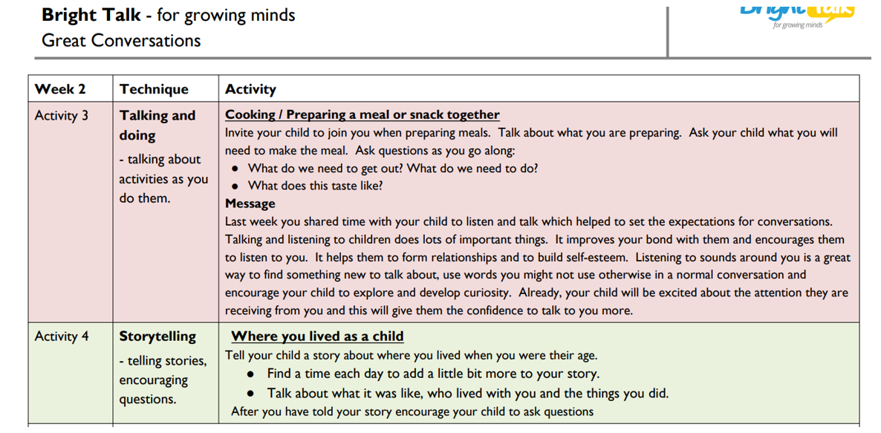

Slide 15
Appendix:
Fitting Talk activities in to a busy life.
Bright Talk works - when it works for you
When?
Who?
What?
How often?
Whenever works best for you.
When you’re walking or travelling together
When you’re out shopping, at the park, the doctors, the hairdressers, etc
At meal time
At bath and bed time
Whoever is spending time with your child.
It can be anyone who spends time with your child – you, grandparents, older siblings, uncle, aunt, family friends or child minder.
What’s happening that you can talk about?
A programme you’ve watched on TV
A book that you’ve read together
A place that you’ve been to together or that they’ve visited
What preferences they have – favourite dinner, superhero, book, etc., and why
As often as possible.
Whatever you can manage, you child will benefit. The more you talk together, the more confident you will both get
All activities can be repeated at any time – this is particularly good if you have a favourite.
Activities can be repeated with different people. This will give your child a different experience – and more learning.

