Slide 1
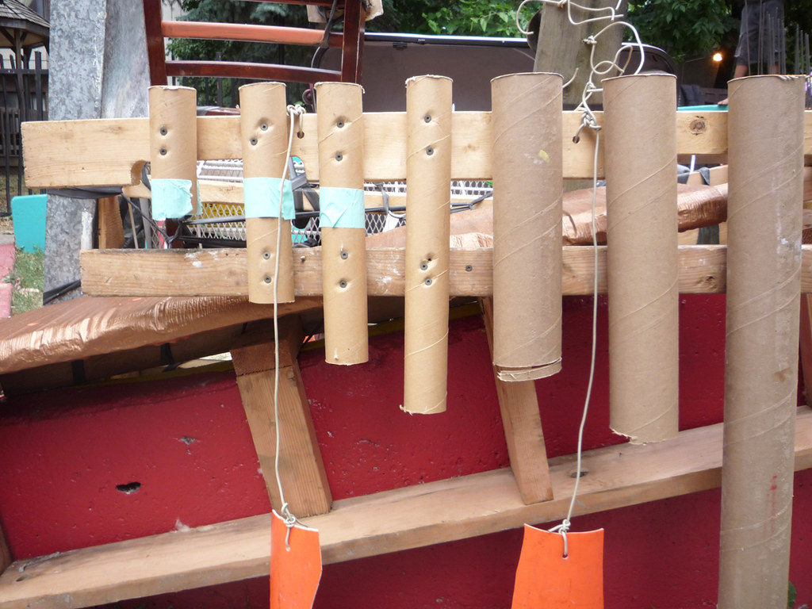
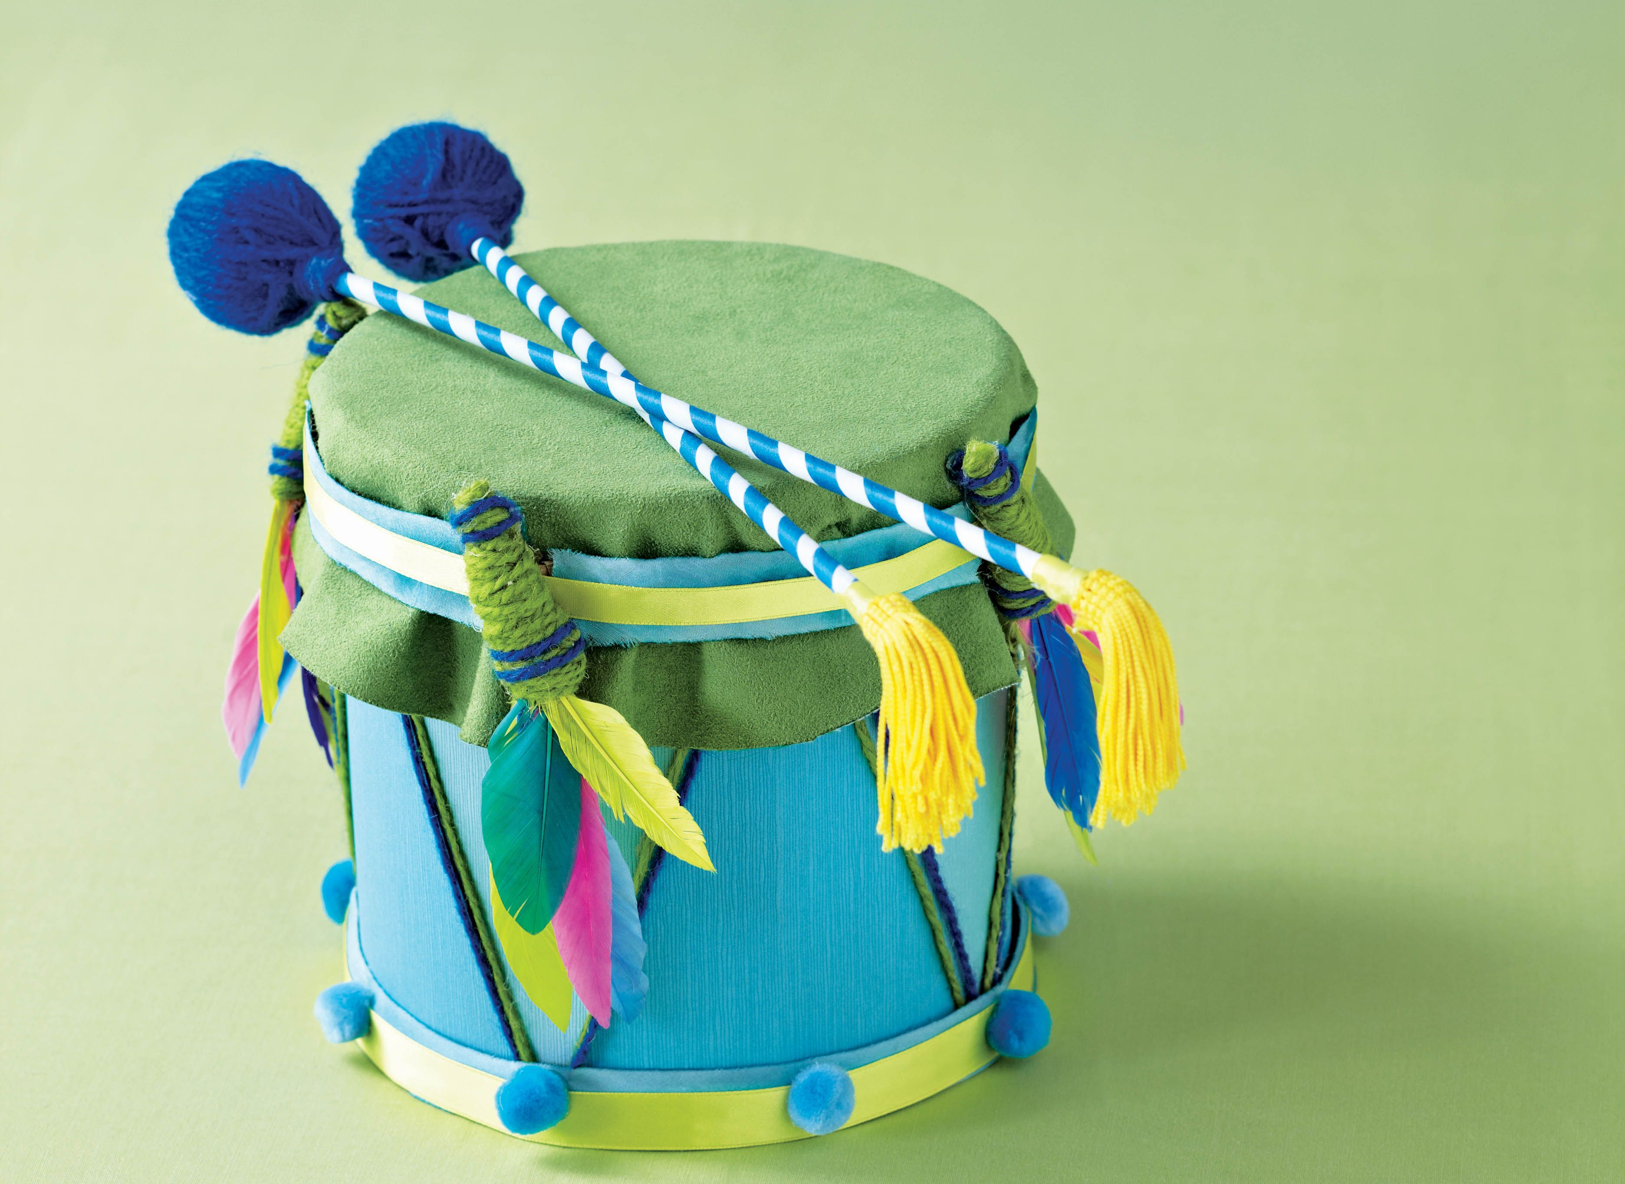
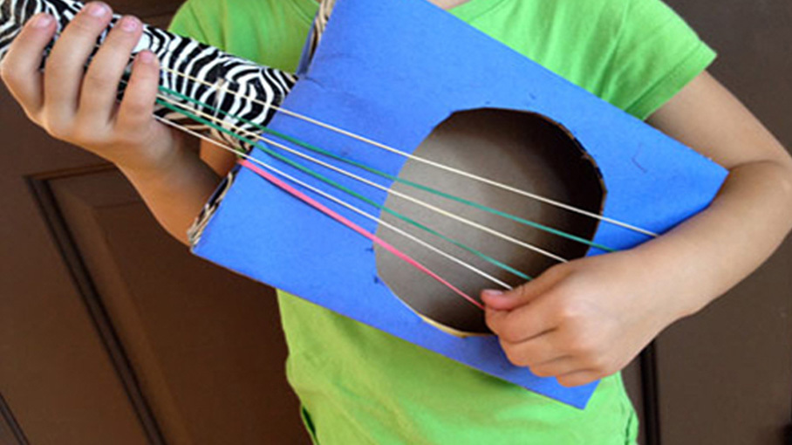
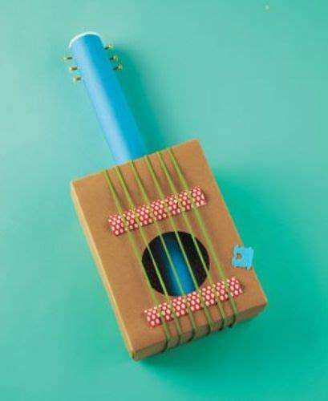
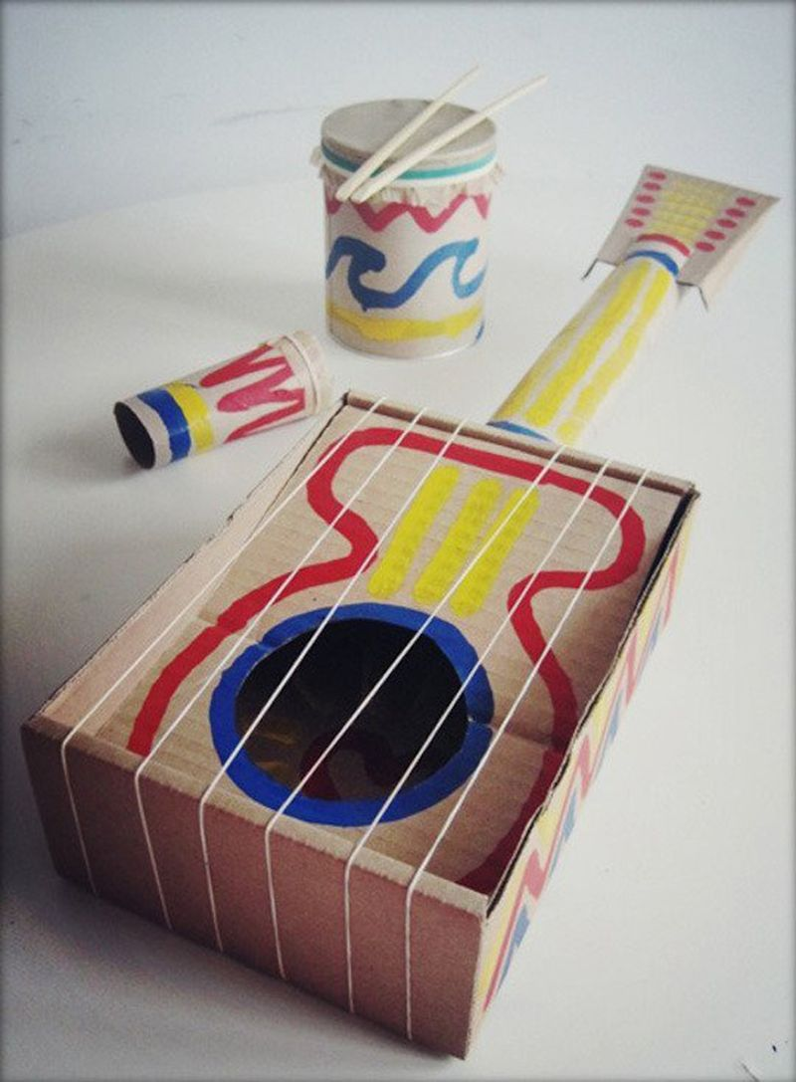
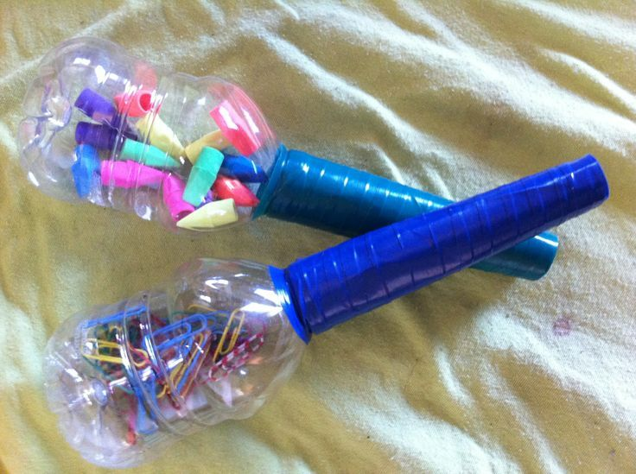
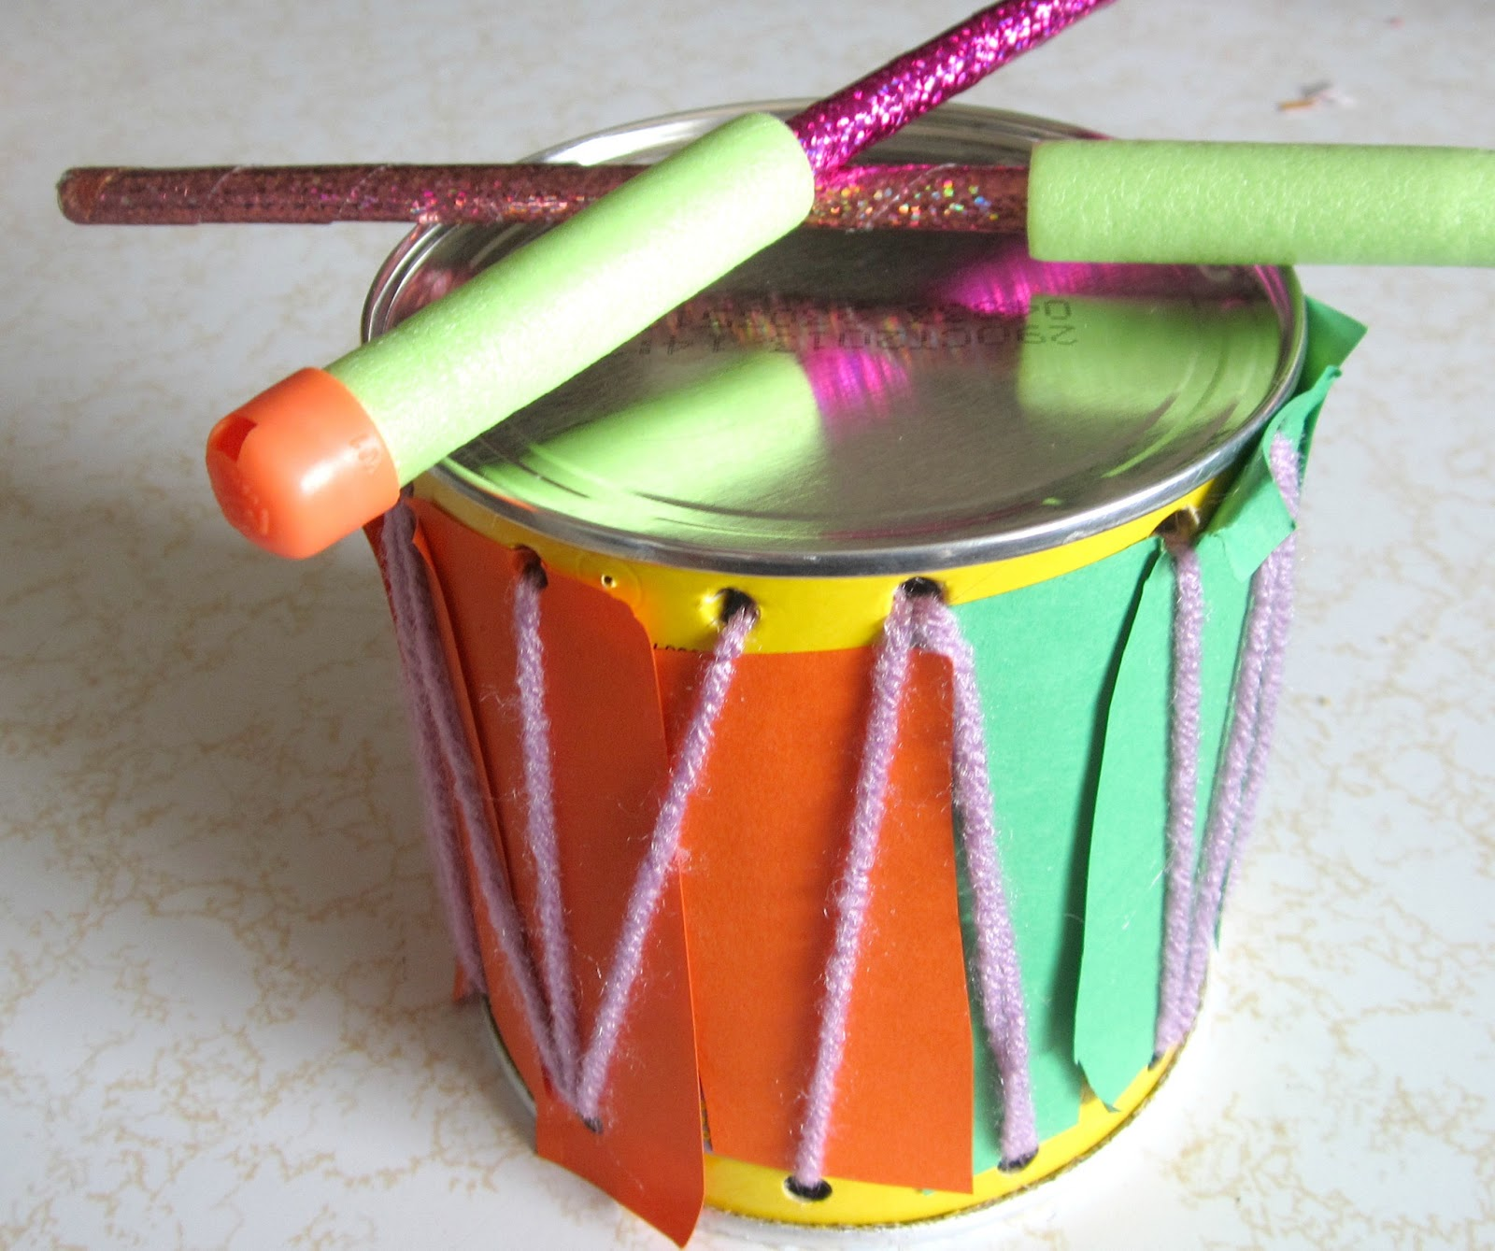
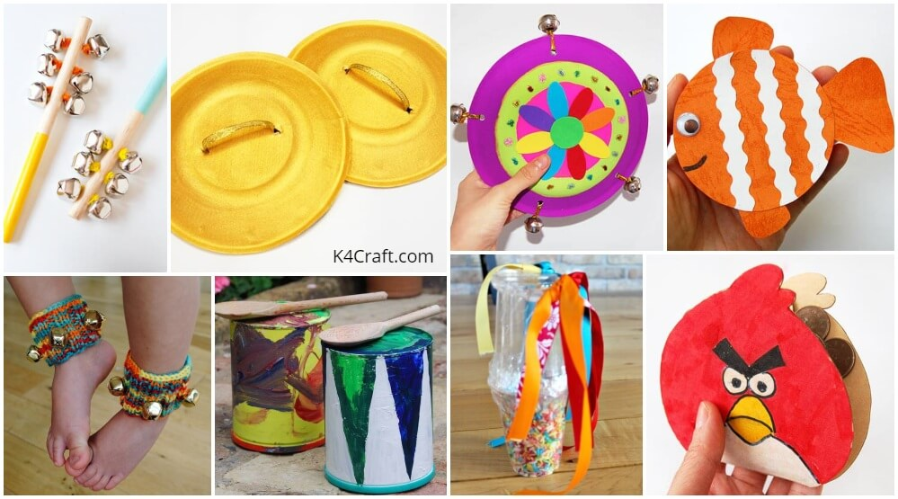
HALF TERM CHALLENGE FROM MRS HAMBLETON!!
Hi children (and grown ups!)
This half term challenge is based on our new value of CREATIVITY!
In school the children really show us that they understand the importance of re-cycling, re-using and looking after our planet and they love to be creative.
So the challenge for this half term is to create an art piece or musical instrument out of re-used and recycled items. Yes…..get creative! Either bring them in or send a photo to Mrs Hambleton.
Here are some ideas….

