Slide 1

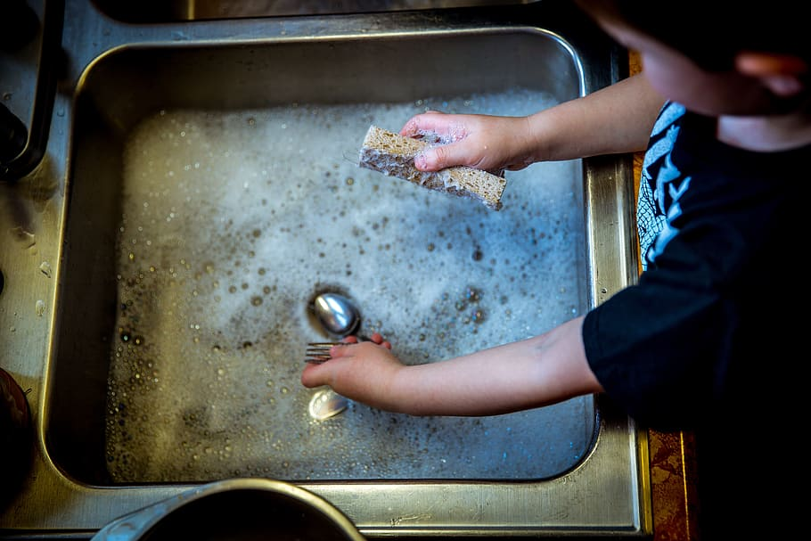
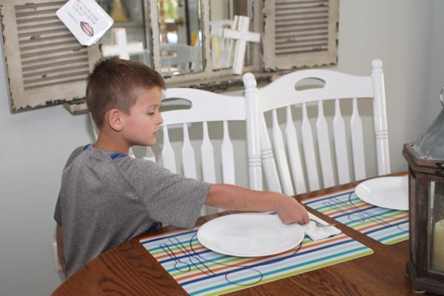
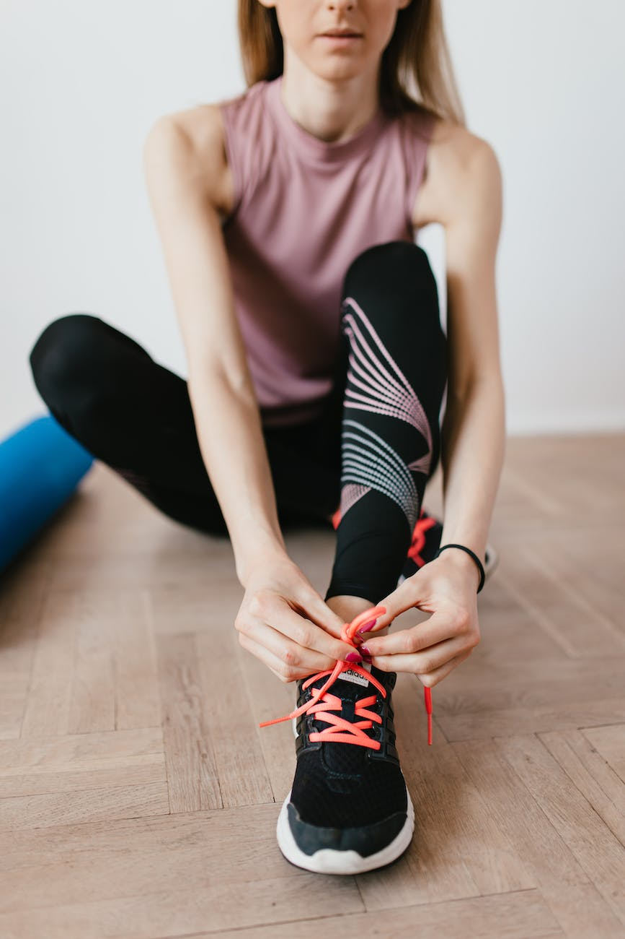
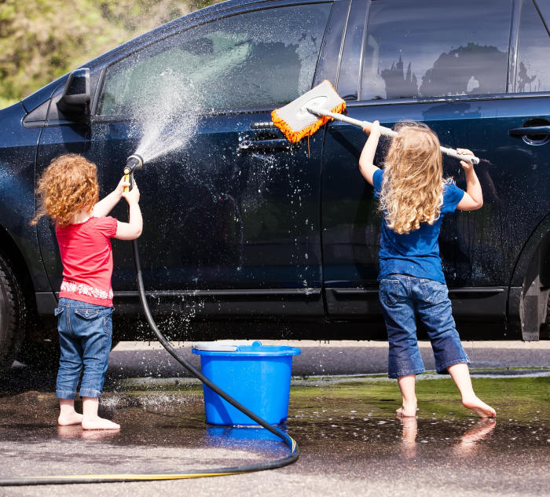
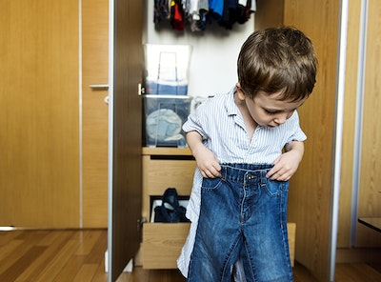
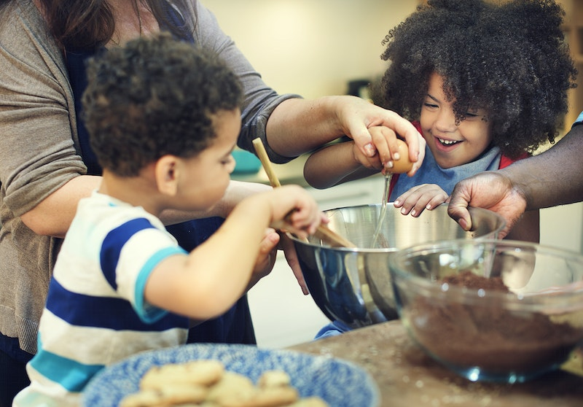
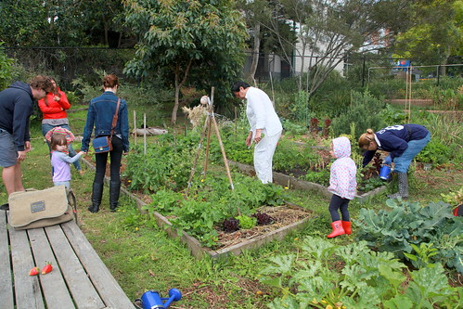

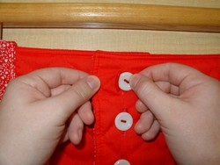
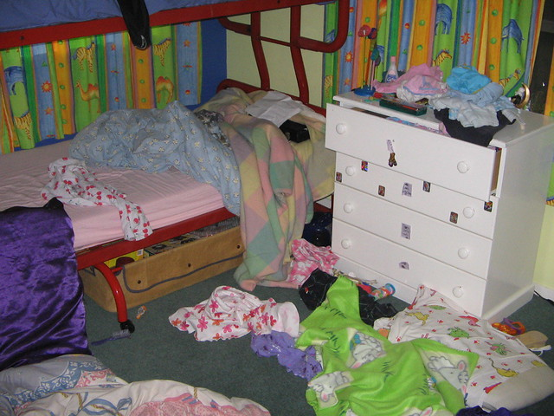
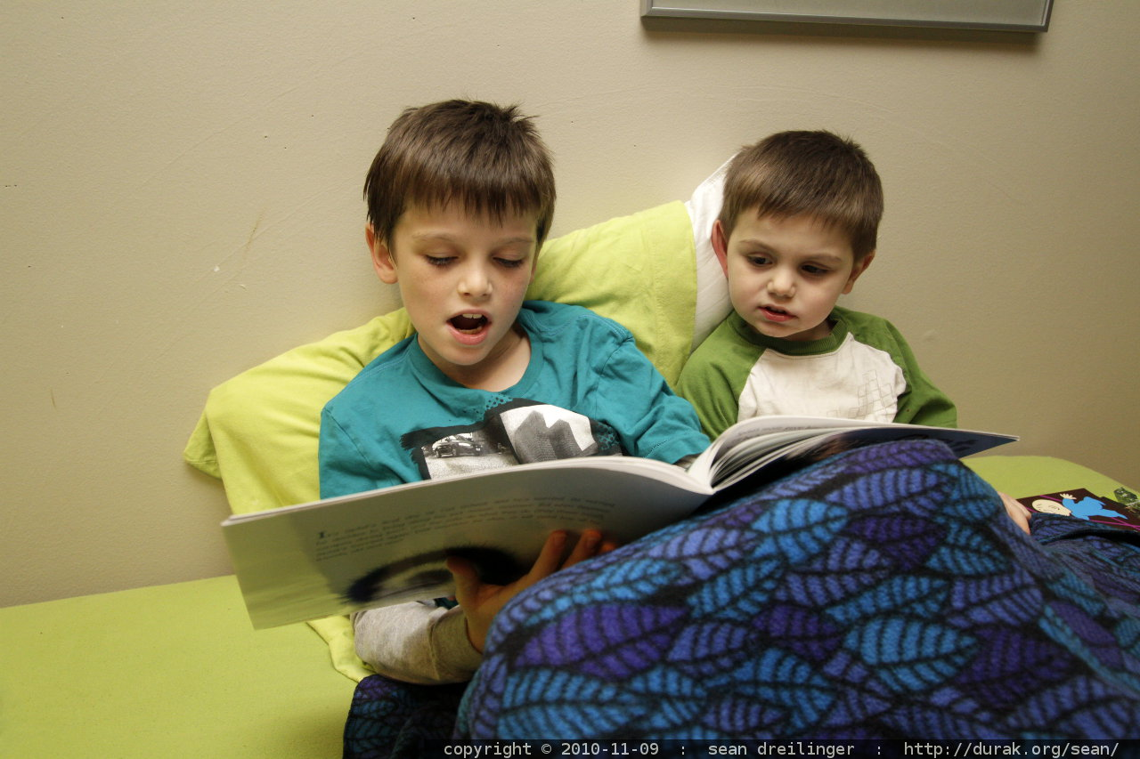

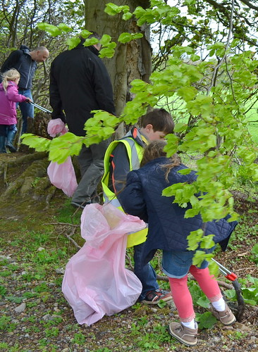
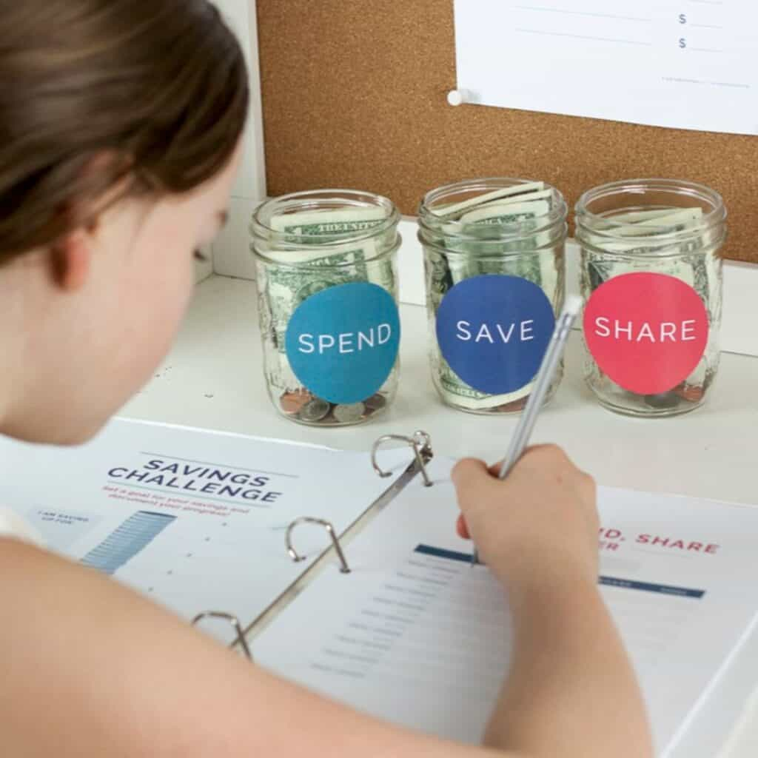
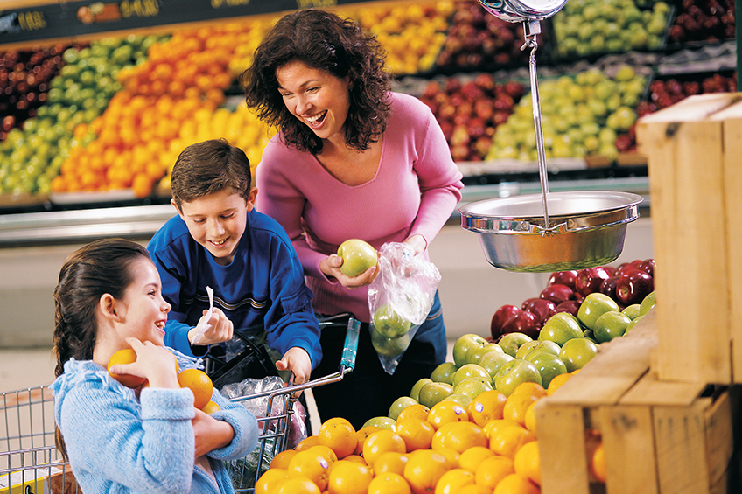
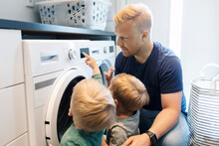

HALF TERM CHALLENGE FROM MRS HAMBLETON!!
Hi children (and grown ups!)
This half term challenge is based on responsibility and independence.
In school many children have a role or responsibility and use their independence and initiative skills to be successful. They take great pride in this!
So the challenge for this half term is to practice a new or already developing responsibility at home or within the community (supported by a safe adult at home) This could be something as simple as practicing a skill that you want to improve on due to your age or something more challenging and creative. Photo’s can be sent to Mrs Hambleton and a badge given to all those children who chose to take part. This challenge should last over time (length dependent on the challenge)….or it wouldn’t be a challenge!
Be responsible and have fun!
Love Mrs Hambleton

