Slide 1
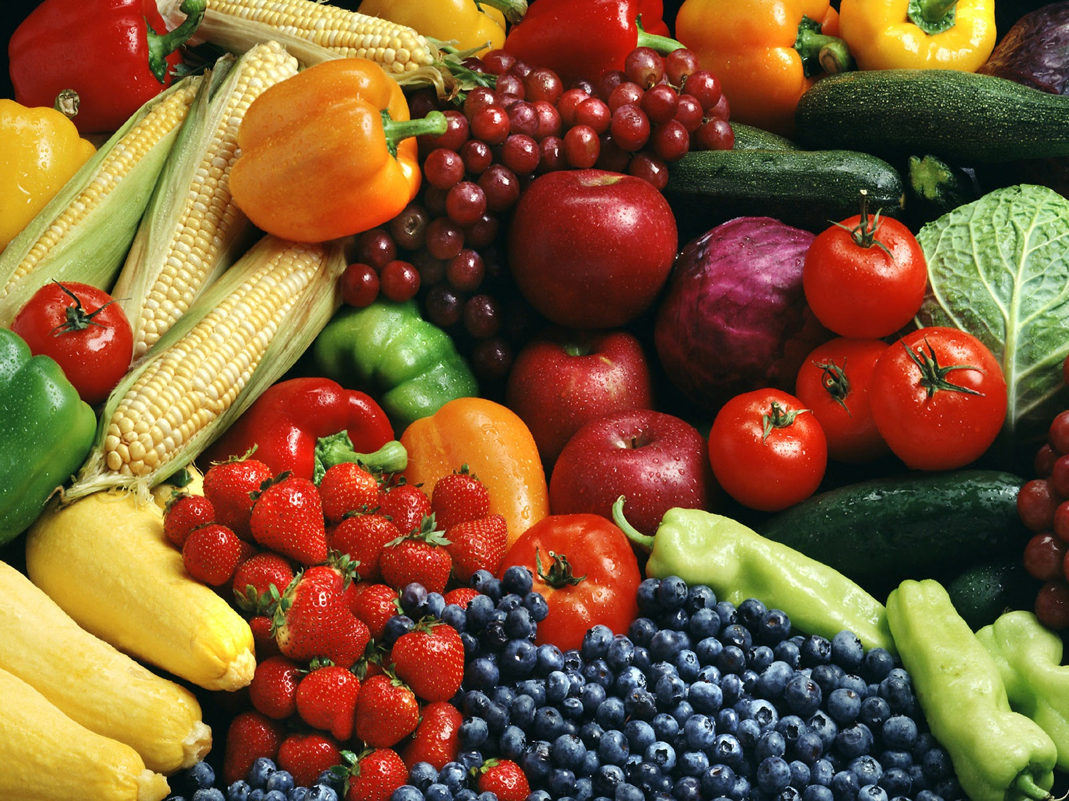
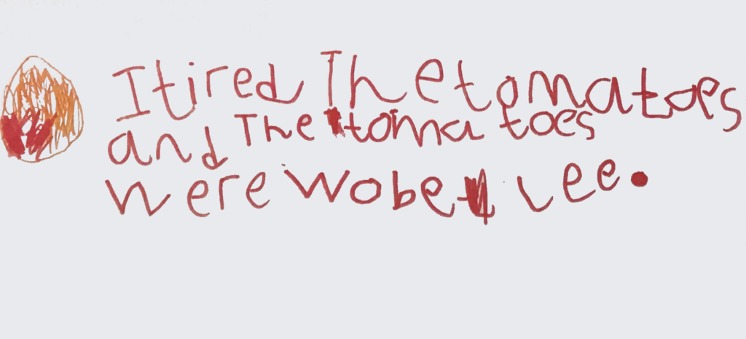






HALF TERM CHALLENGE FROM….
MRS WILKINS!!
Hi children (and grown ups!)
INTRODUCE YOU AND WHAT YOU ARE LEADING ON…THE WHY….
So, this half terms challenge is a little different….
INTRODUCE WEBSITE AND WHAT YOU ARE ENCOURAGING
https://www.tasteeducation.com/activities/
WHERE ARE PHOTOS GOING
AND MENTION A DISPLAY
IN THE HALLL
Mrs Wilkins

