Slide 1

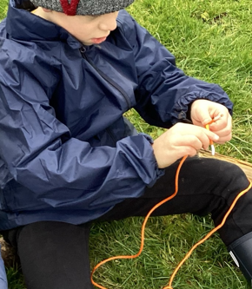
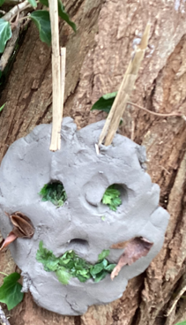
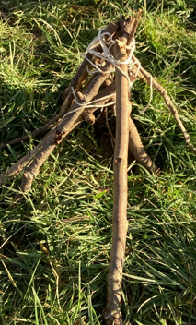
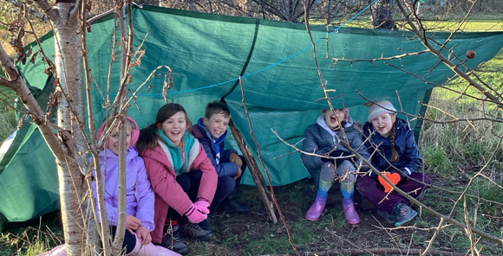
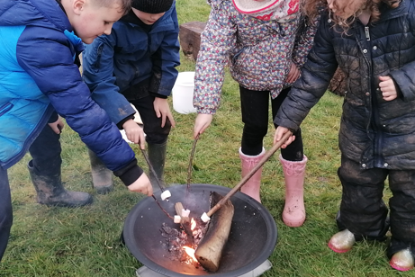
Lawn Curriculum Newsletter
Focus on Forest School
16.02.2024
Forest School
Welcome to the first Forest School newsletter. We hope this gives you an overview of what Forest School is all about and why we have chosen to introduce it here at Lawn Primary School.
Forest School is an outdoor educational programme that is child-centred. It allows children to connect with nature first-hand through each season. It develops their physical, emotional and cognitive learning through strengthening activities, problem solving and collaborative tasks.
It allows children to take risks in a controlled environment that they may not get the opportunity to do but also allows them to develop an environmental awareness, one which links to our Lawn Values.
All children at Lawn will get to participate in Forest School at some point this year and we hope those that already have, have spoken enthusiastically about the experience.
Let’s look at some of the activities the children take part in.
We always start the session with our ‘Forest School Agreement’
Practising to tie a Reef Knot.
Finding our safe tree and making a Tree Guardian to protect it!
Year 1 building tepees for Stick Man!
Toasting marshmallows over our fire.
Using our knots to build a den.
‘DREAM, BELIEVE, ACHIEVE’

Slide 2
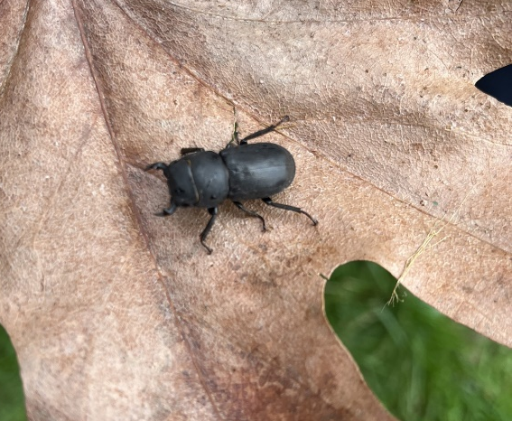
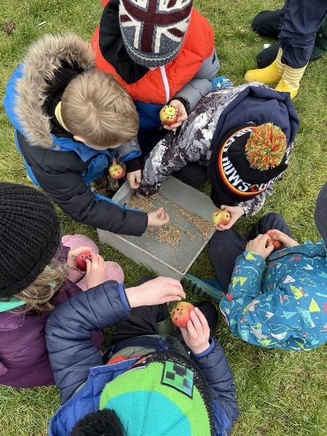
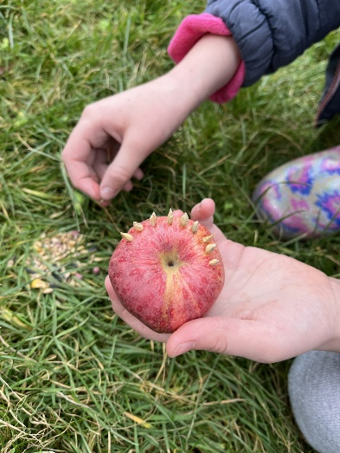
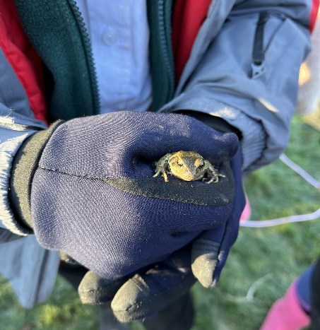
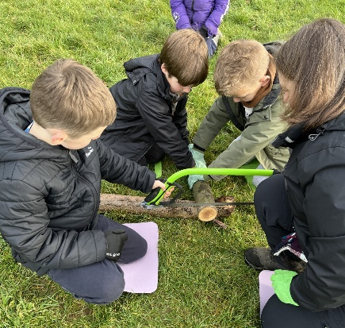
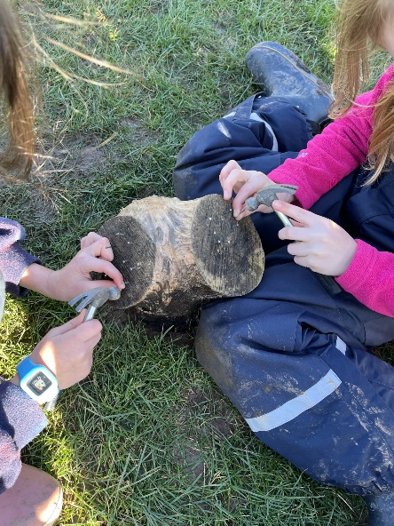
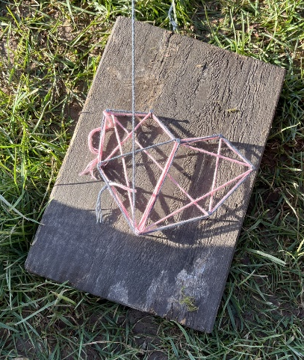
Forest School
Remember Forest School takes place in all weathers so children must come dressed appropriately, we may get wet and sometimes muddy!
Making bird feeders!
Finding different animals and insects!
“I’ve loved doing Forest School! It’s my favourite part of the week.” – Year 4 child.
“I have learned how to light a fire!” – Year 3 child.
“I was scared to use a saw to chop wood but I did it!” -Year 4 child.
“It is cold outside but I’m having fun!” – Year 1 child.
“I can’t wait to do Forest School in the summer term!” –Year 6 child.
Using tools to help create art!
‘DREAM, BELIEVE, ACHIEVE’

