Slide 1
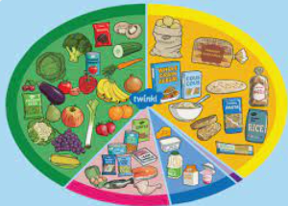
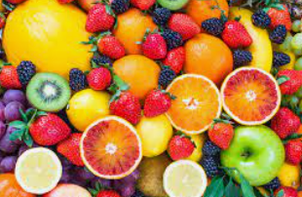
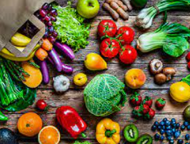
Our Lawn Healthy Recipe Book
Here you can find some healthy recipes to try at home.

Slide 2
Savoury

Slide 3
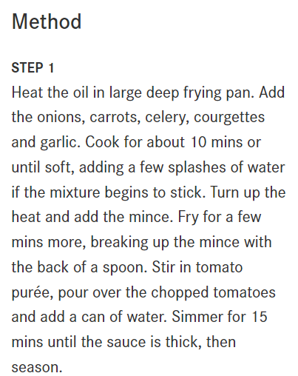
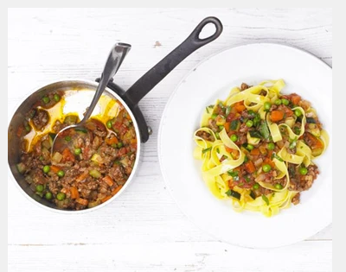
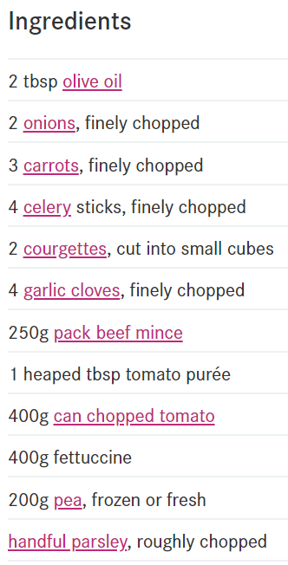
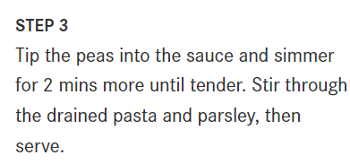
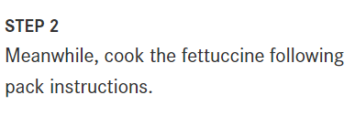
More Veg, Less Meat Bolognese
https://www.bbcgoodfood.com/recipes/more-veg-less-meat-summer-bolognese

Slide 4
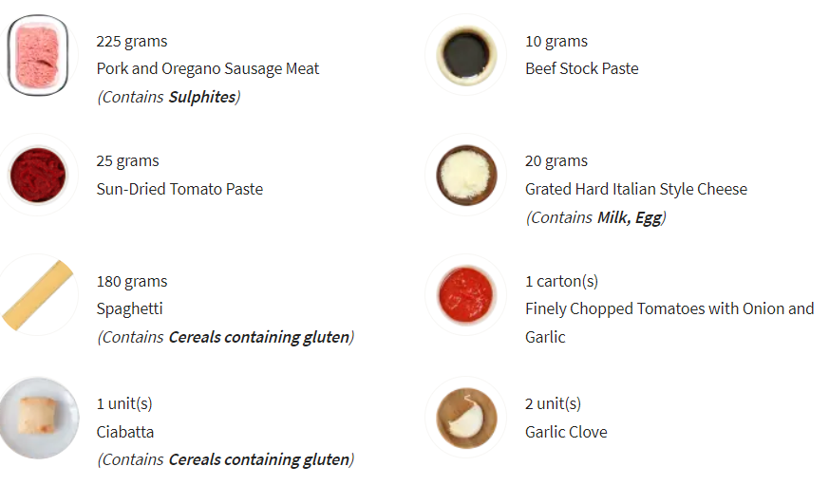
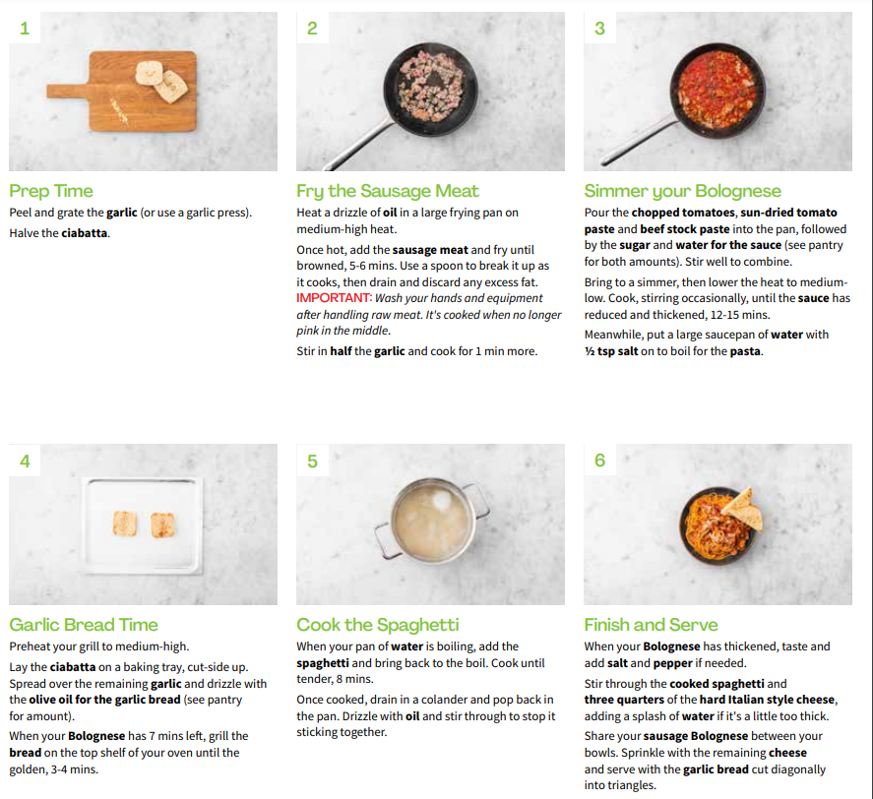
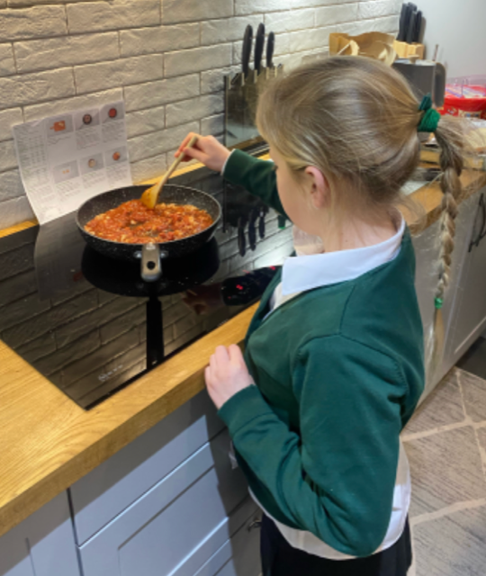
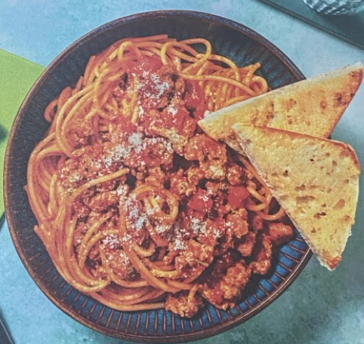
Oregano Sausage Spaghetti Bolognese
A recipe from one of our Year 4 pupils from Hello Fresh.

Slide 5
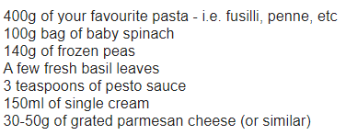
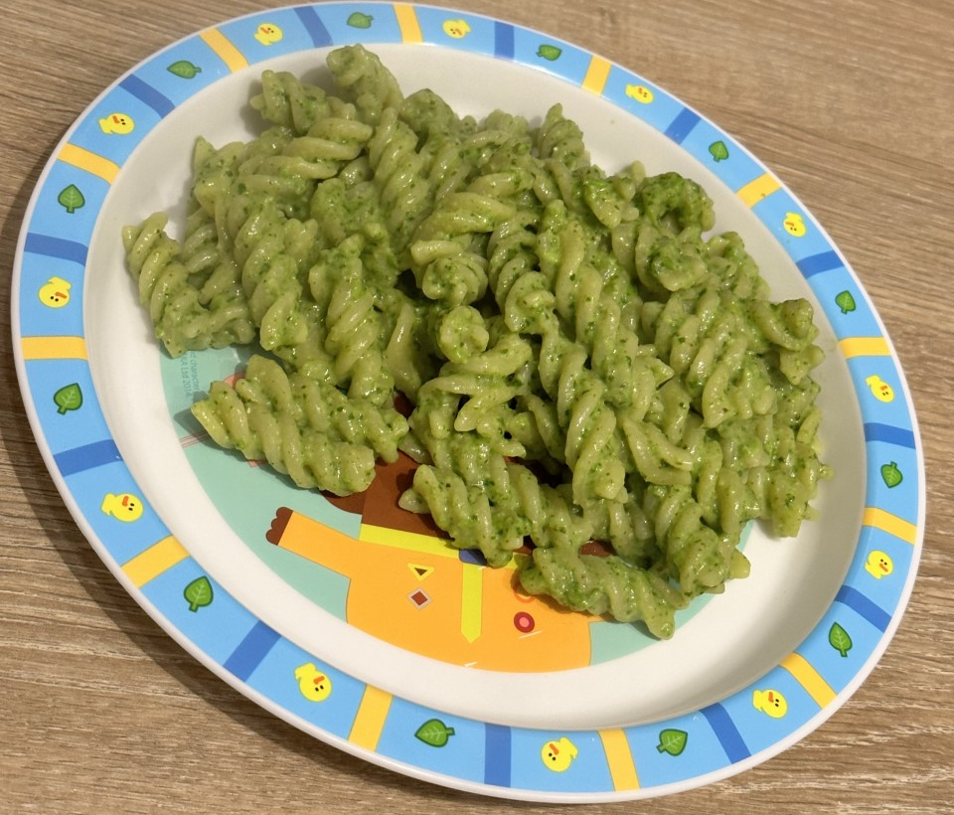
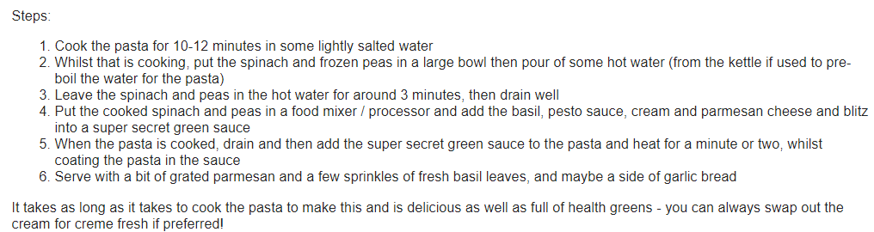
Super Secret Green Sauce Pasta.
A recipe from one of our FS2 pupils.

Slide 6
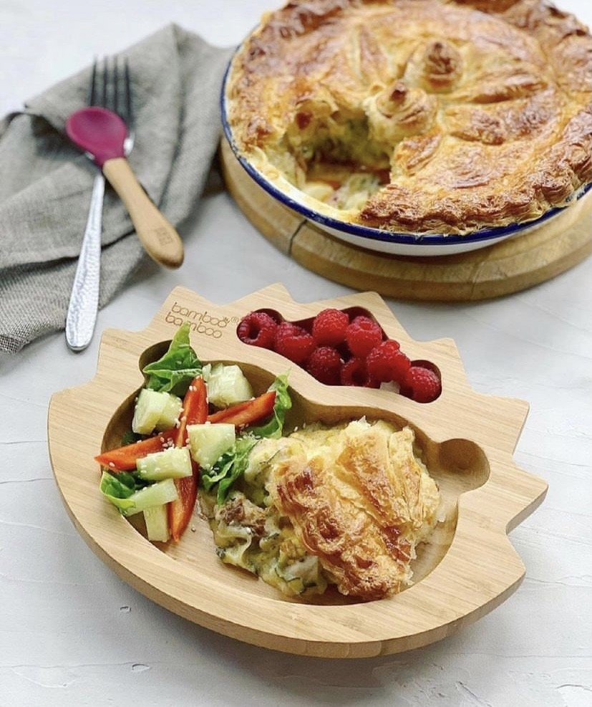
Chicken Pie with Hidden Veggies
Ingredients;
• 2 medium courgettes, grated
• Freshly ground black pepper
• 2 tablespoons of corn flour
• 300ml of milk (cows or plant based)
• 150g of grated cheddar cheese (or 2 tbsp of nutritional veast)
• A small knob of butter (or coconut oil)
• Half a packet of ready roll puff pastry
• 1 low salt stock cube (chicken or veg)
• 1 egg or more milk
• 2 handfuls of your chosen pie fillings. Yesterday I used left over Sunday roast chicken and mushrooms.
Optional fillings:
• Hard boiled eggs
• Roasted veg like butternut squash
Fresh fish chunks (fish pie mix would work well)
• Cooked tinned lentils
• Tinned beans
• Sautéd leeks
Method;
1) Add the milk to a jug and microwave for 2mins. Grate the courgettes, and add to a saucepan with a small knob of butter, cook for 4 minutes.
2) Add the cornflour and cook for a minute then crumble in the stock cube, add the milk and black pepper. Keep stirring till thickened, around 2-5 mins.
3) Add your cooked pie filing to the sauce along with the cheese, stir and transfer to a oven dish.
4) Top with pastry, cut a hole in the middle to allow steam to escape, and brush the pie with beaten egg or milk to glaze. Bake at 200 degrees for 25 minutes until golden and puffed up.
Prep: 15 mins - Bake: 25mins
A recipe from one of our Y3 pupils.

Slide 7
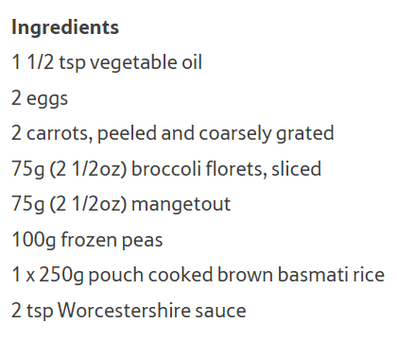
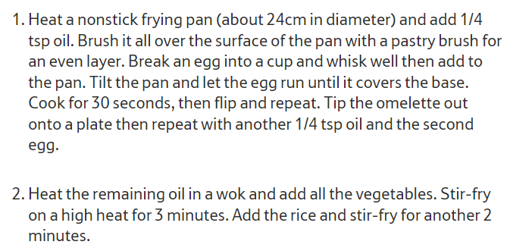
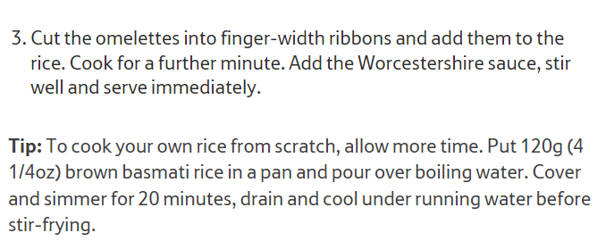
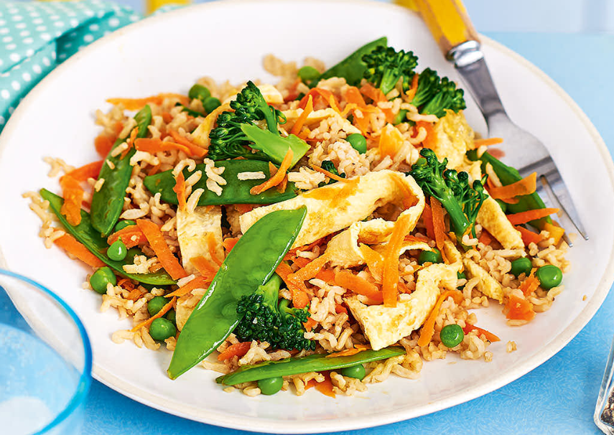
Vegetable Fried Rice
https://realfood.tesco.com/gallery/10-healthy-recipes-for-kids.html?id=d1a51db9-9c7a-4791-bc55-c1b0aa44580e

Slide 8
Desserts

Slide 9
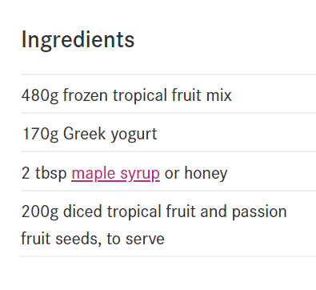
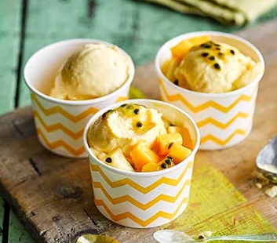
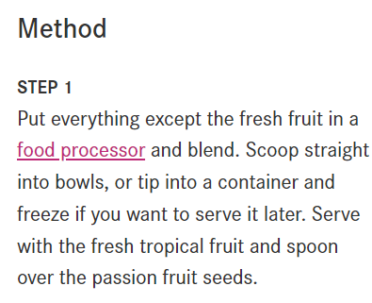
Frozen Tropical Fruit Yoghurt
https://www.bbcgoodfood.com/recipes/frozen-tropical-fruit-yogurt

Slide 10
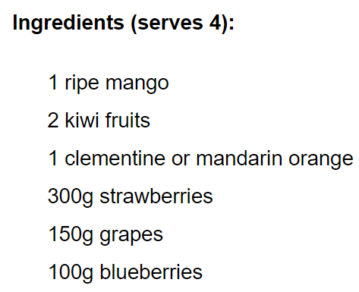
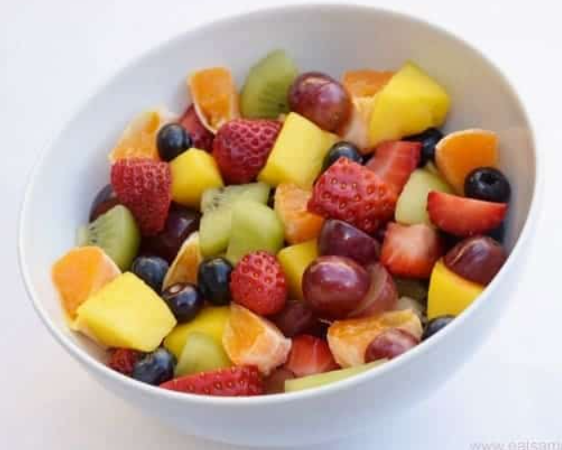
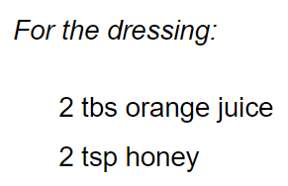
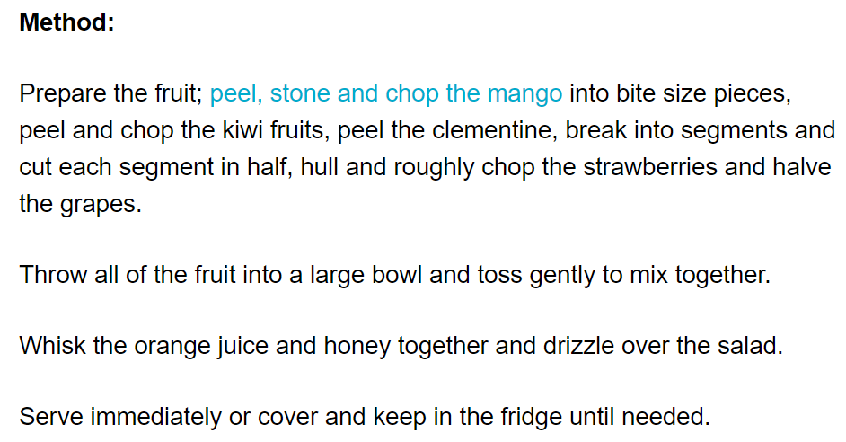
Easy Rainbow Fruit Salad
https://www.eatsamazing.co.uk/rainbow-food/easy-rainbow-fruit-salad-recipe

