Slide 1

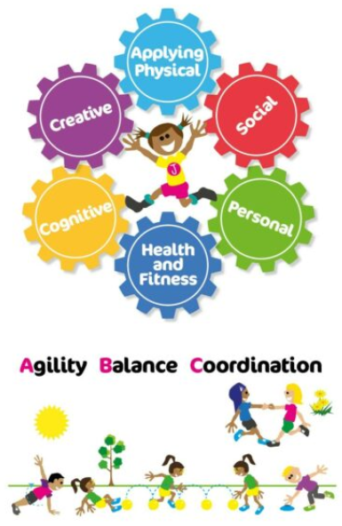


PE at Lawn
Intent Statement
Our intent for PE at Lawn is to create a curriculum that focuses on learning behaviours and fundamental movement skills rather than sporting ability. This allows children to feel valued and included so that high-quality learning takes place.
Implementation: Scheme
We use Real PE, Real Gym, Real Foundations and Real Dance.
Implementation: Planning
Our school uses the platform Jasmine to deliver high-quality PE lessons across the school.
Implementation: Curriculum links
Our learning nutrition framework is implemented throughout the school to ensure that we have well-rounded citizens going out into the world.
Implementation: Resources
Our school has been resourced to support the delivery of Real PE in school. We are now looking into ordering some larger gymnastics apparatus for both halls in order to support us with our delivery of Real Gymnastics.
Implementation: Lesson Sequence
All of our lessons, for all of our year groups, follow the same format of Warm Up, Skill, Skill Application and Review.
Each part of the lesson will differ depending on the fundamental skill movement for that lesson.
Implementation: T & L / Pedagogies
It starts with a belief and ambition that PE is a subject that every child can enjoy and be successful in.Here at Lawn we are developing good reliable and consistent teaching habits leads to positive learning behaviours in children, and positive learning behaviours lead to outstanding development of skills, knowledge and attitudes in PE. In high quality PE, the language and environment are inclusive and make every child feel valued. There is a clear focus for learning which every child feels is achievable and relevant; every child can access all parts of the lesson and praise is predominantly based around positive behaviours and progress.

Slide 2
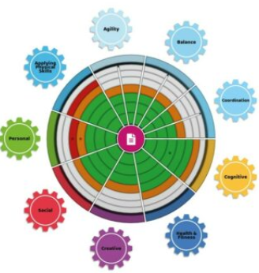
PE at Lawn
Implementation: Environment
Real PE display showcases the high-quality learning taking place within school as well as displaying the learning behaviour for the half term.
The Jasmine platform is displayed during each lesson so that the children can see the learning displayed clearly and watch the videos during the lessons.
Implementation: Feedback
Children are encouraged to give feedback to each other during lessons and during the review part of each lesson.
Implementation: How Groups are Supported
(SEND, GDS, PP, disadvantaged, EAL)
Additional videos are provided to support pupils with physical disabilities. The skill videos are colour coded to support all pupils.
Children can choose their level of challenge to make the skill inclusive to all. We are also beginning to use digital to record skills and watch them back so that children can see what their next steps are.
Implementation: Response to Covid
Real PE at Home is accessible on the Jasmine platform and was set during the lockdown period.
Impact: Assessment
Impact: Evidencing
Impact reports are generated each year from assessment gathering.
AFL is completed during all lessons and feedback can be given live during the lesson both my peers and adults.
Impact: Monitoring
YW monitoring through questionnaires, lesson observations and walk rounds.
CPD opportunities are provided regularly for staff.

